Slide 1
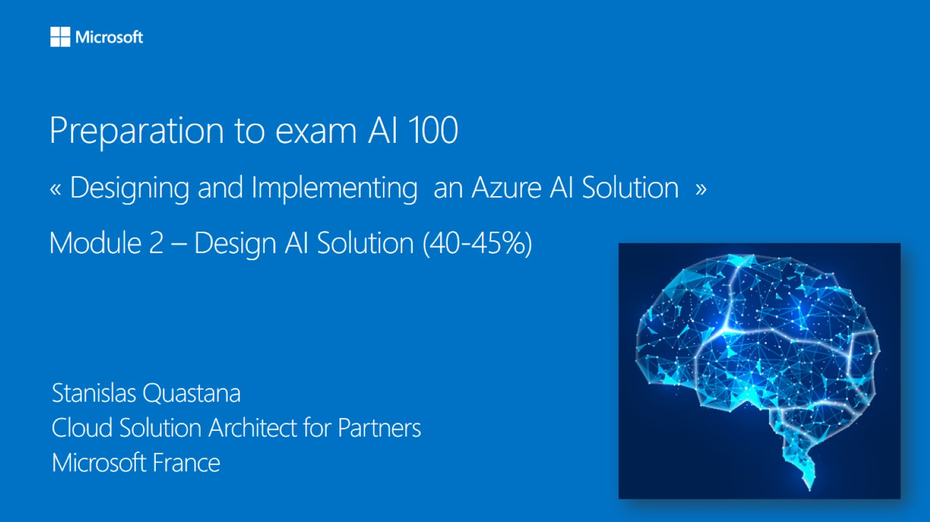

Meet Bhagdev
Program Manager
Microsoft

Slide 2
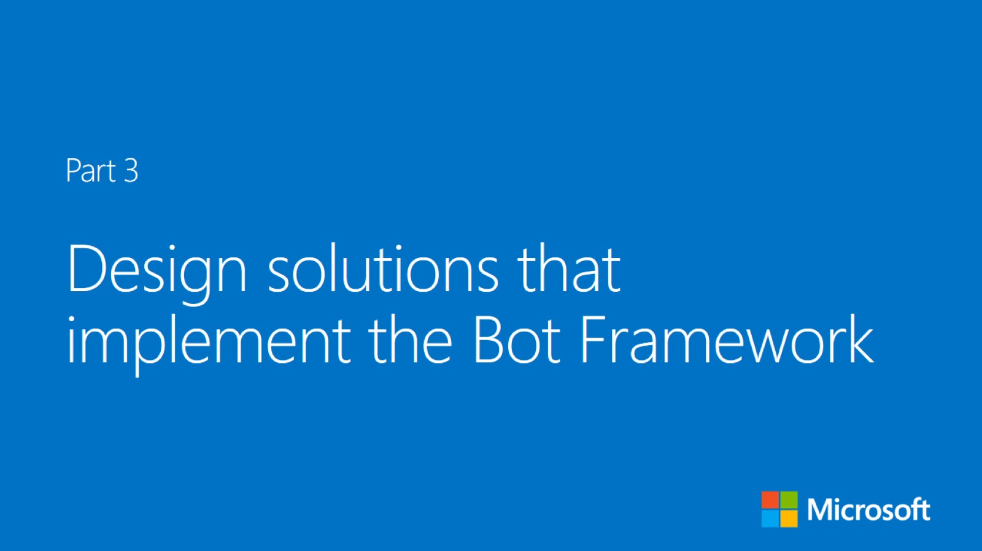


Slide 3
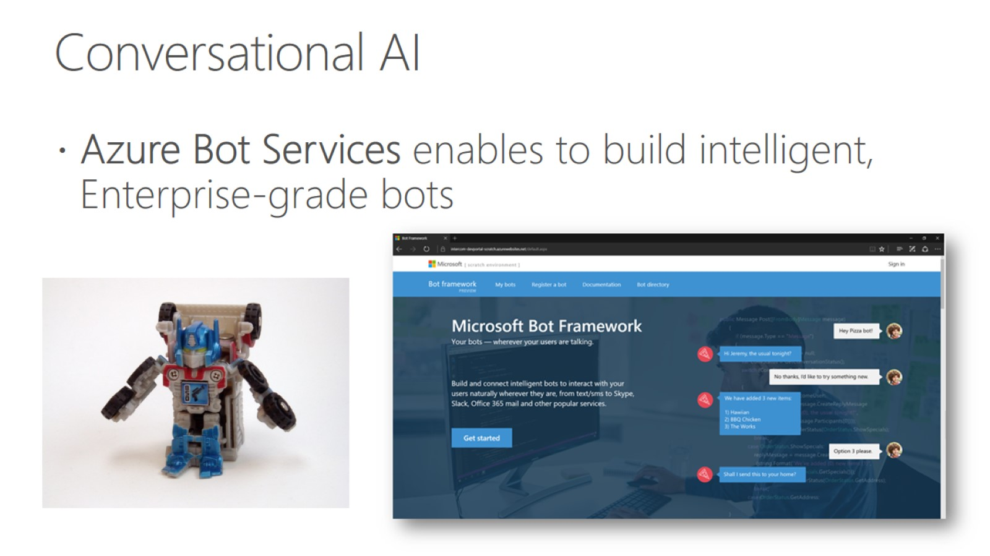
Conversational AI

Slide 4
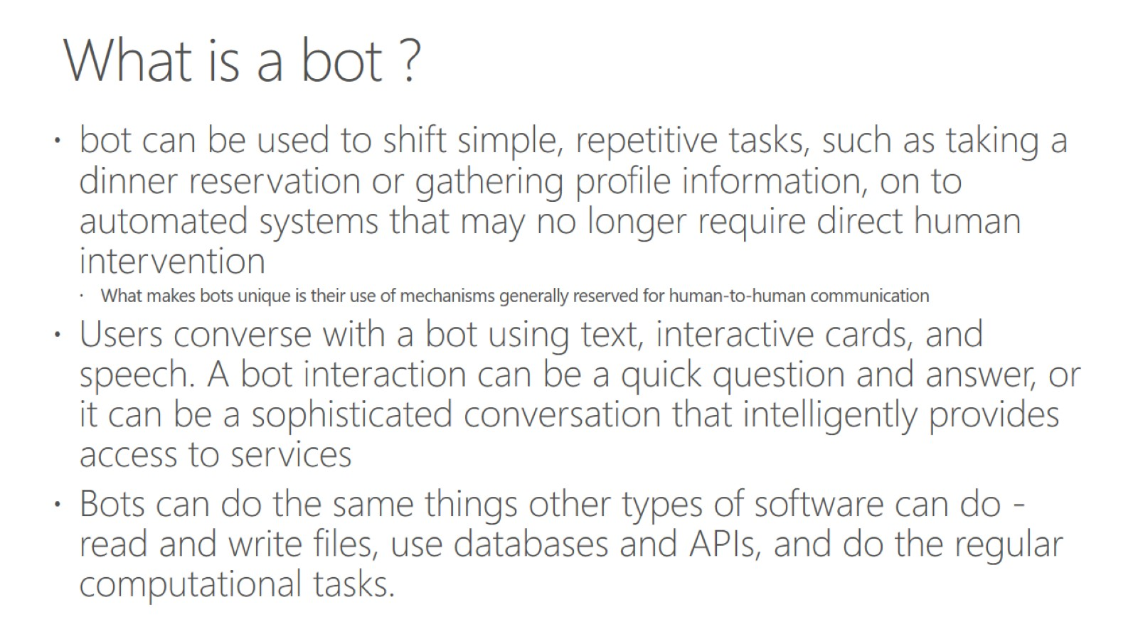
What is a bot ?

Slide 5
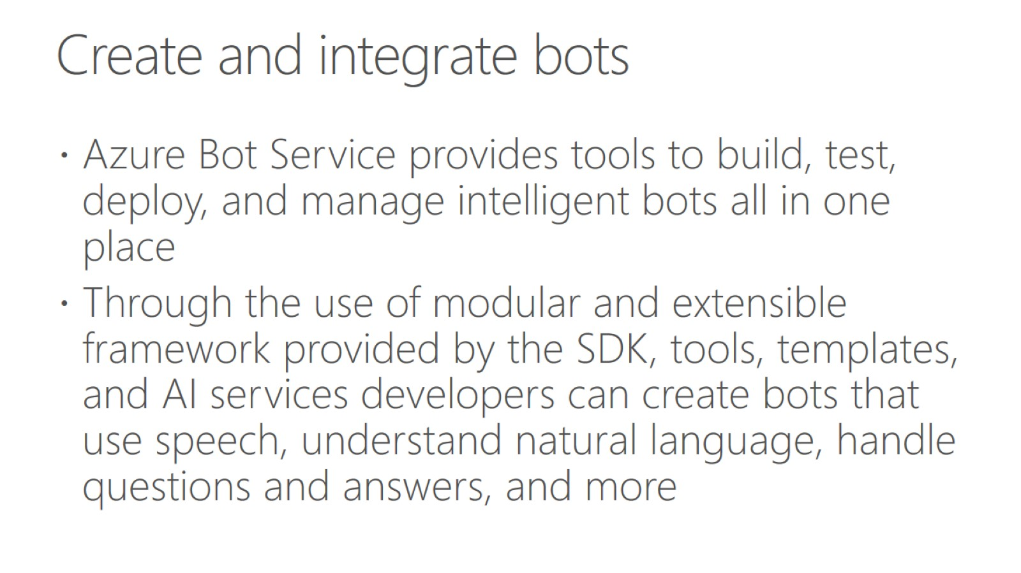
Create and integrate bots

Slide 6
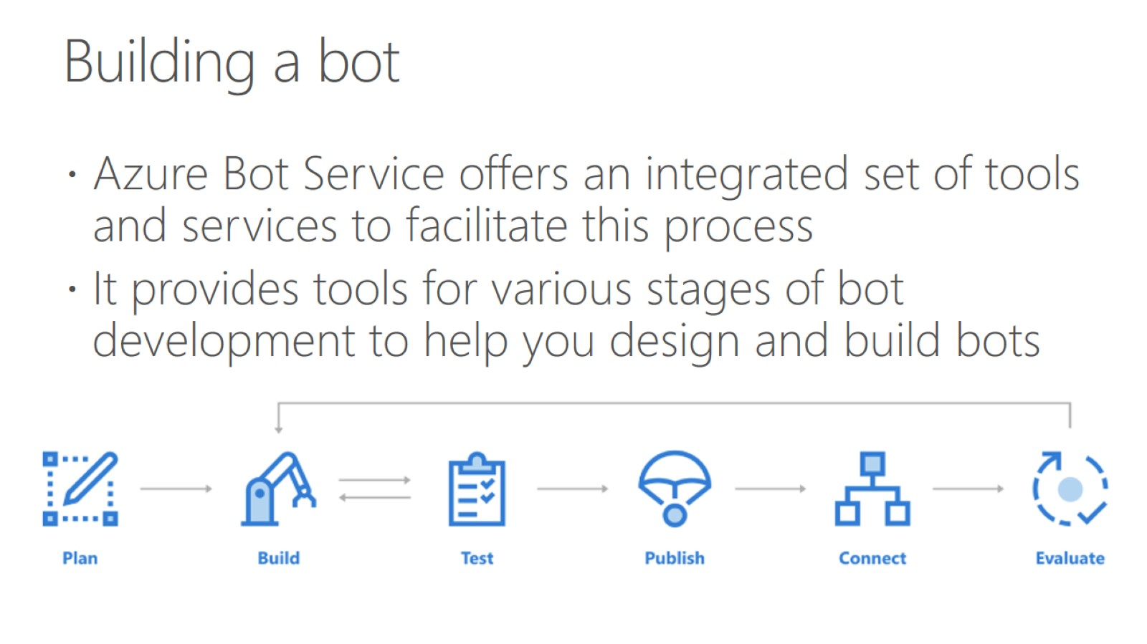
Building a bot

Slide 7
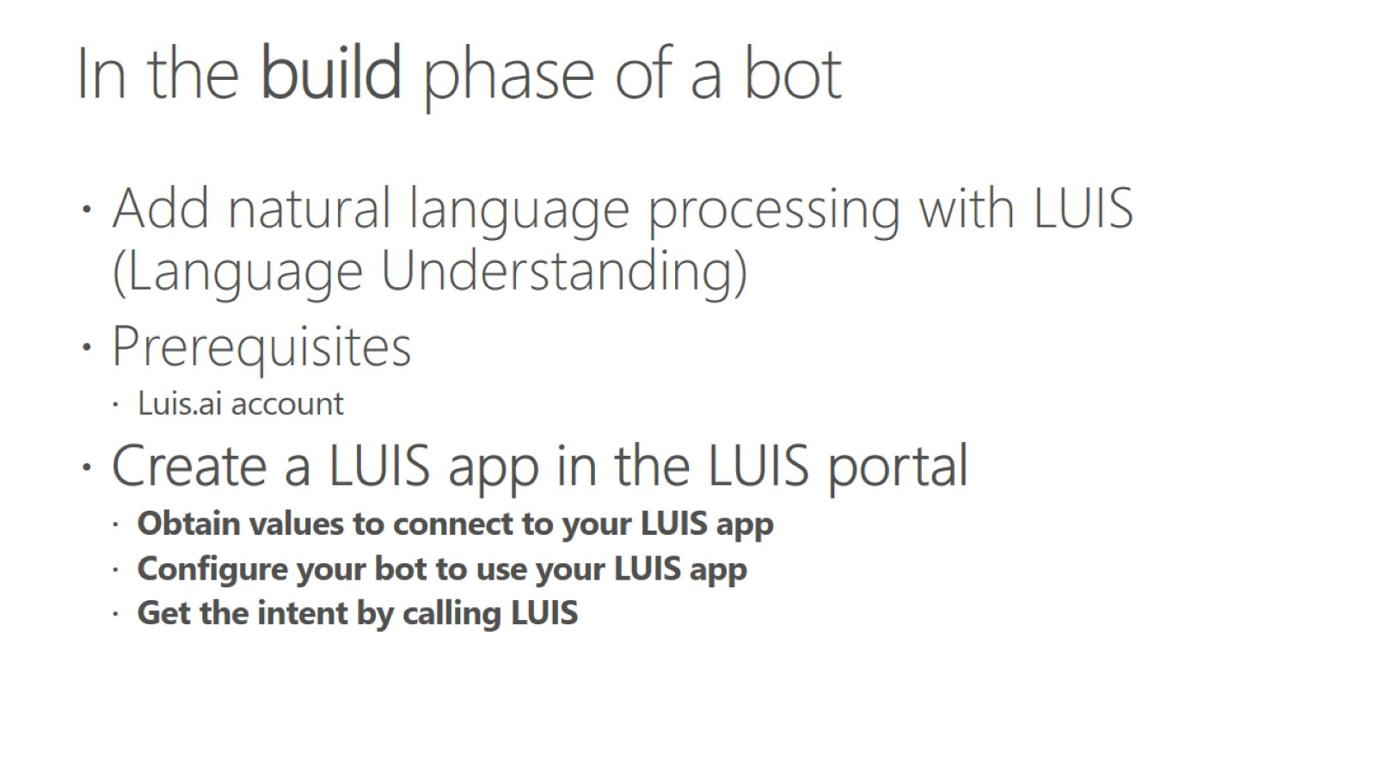
In the build phase of a bot

Slide 8
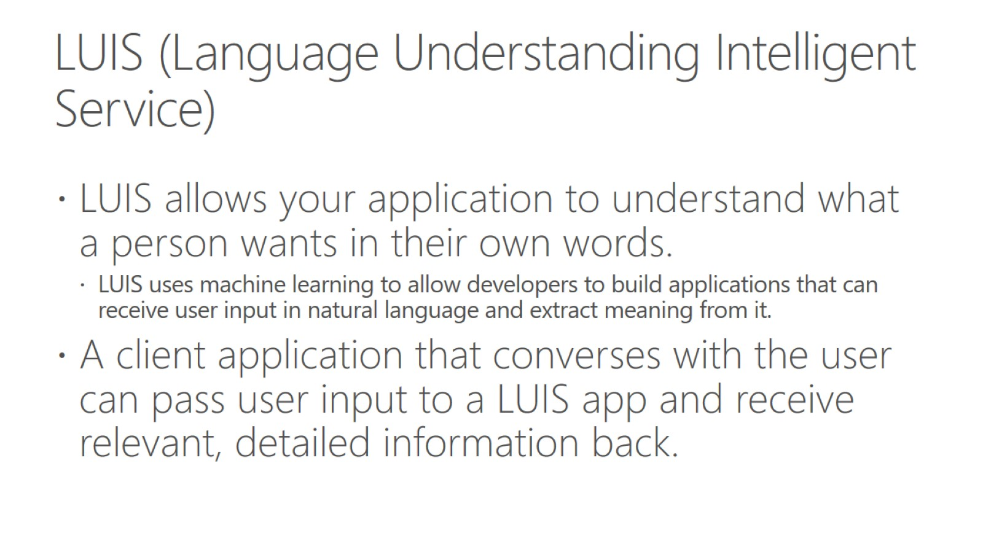
LUIS (Language Understanding Intelligent Service)

Slide 9
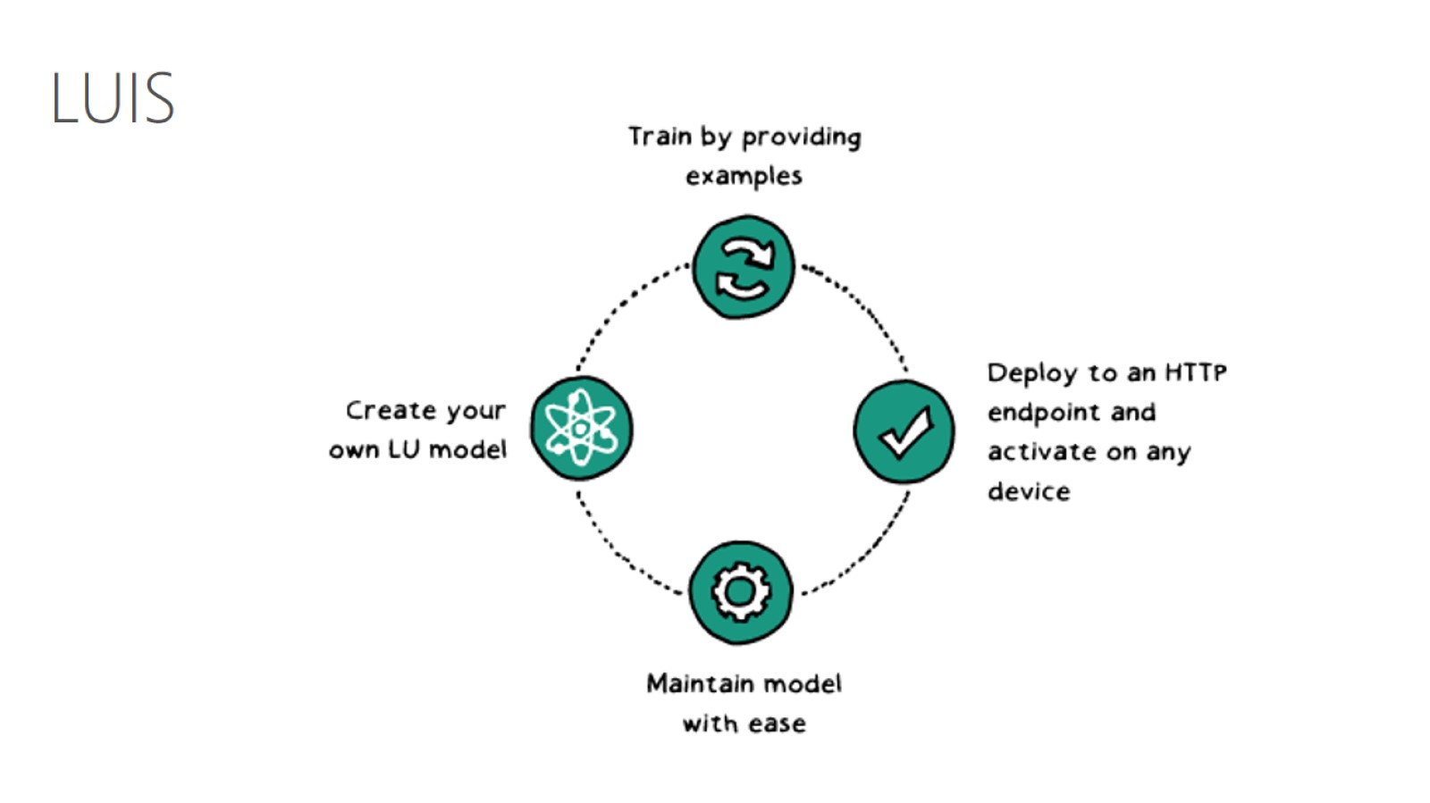

Slide 10
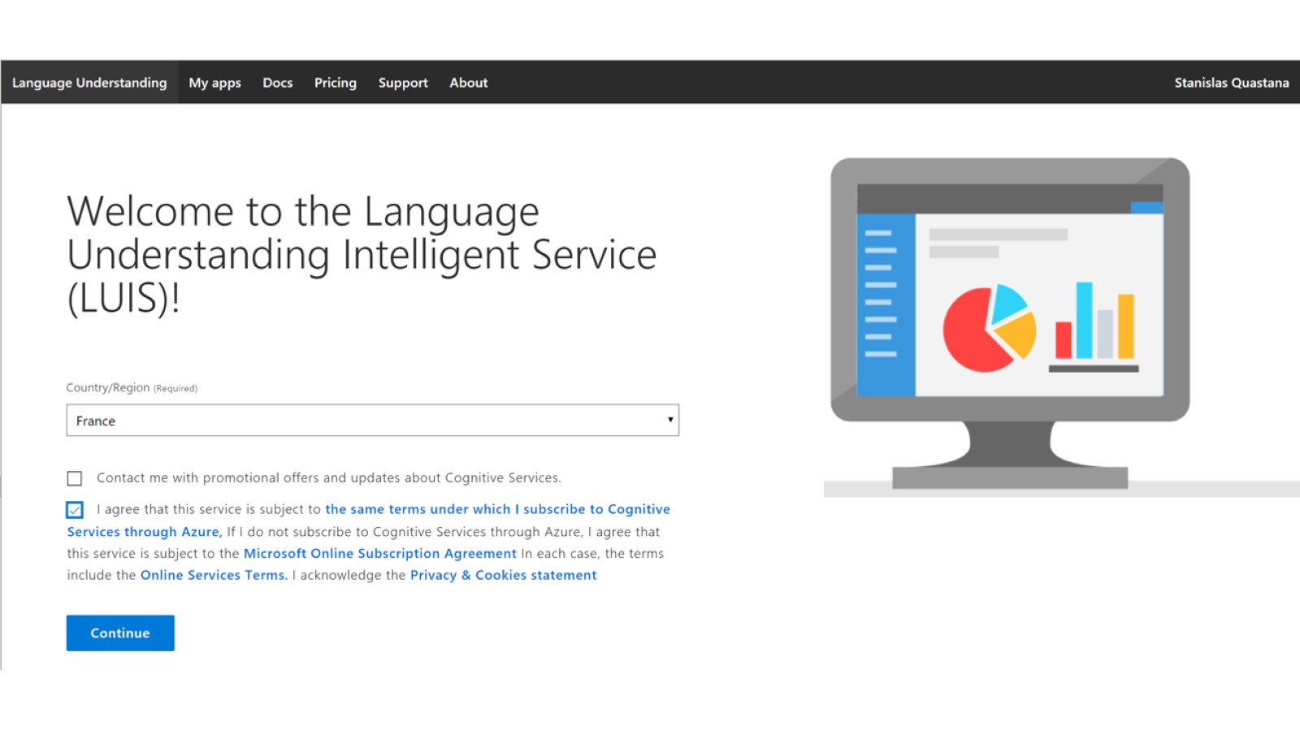

Slide 11
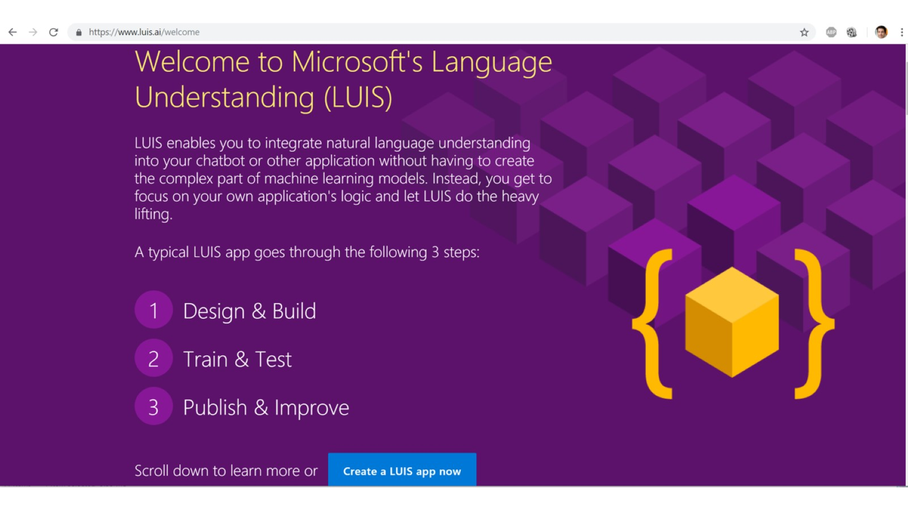

Slide 12
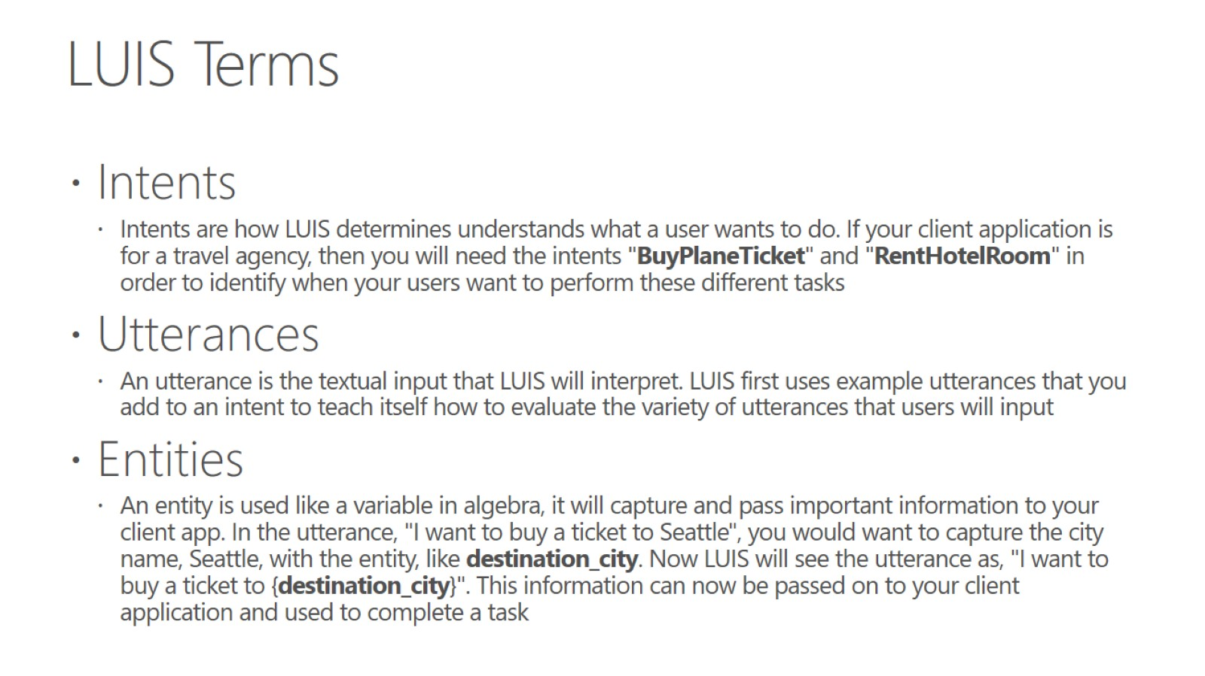
LUIS Terms

Slide 13
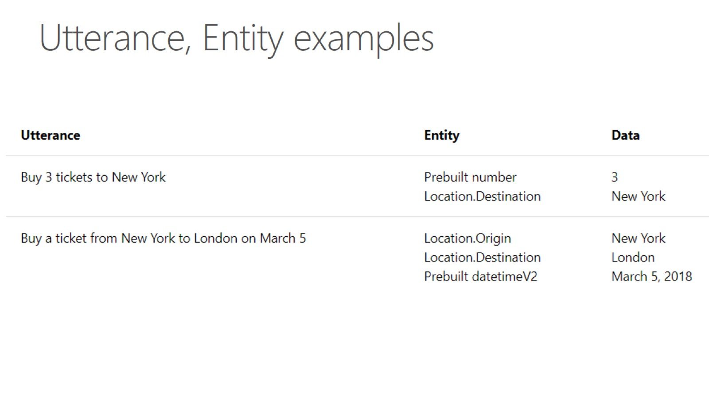
Utterance, Entity examples

Slide 14
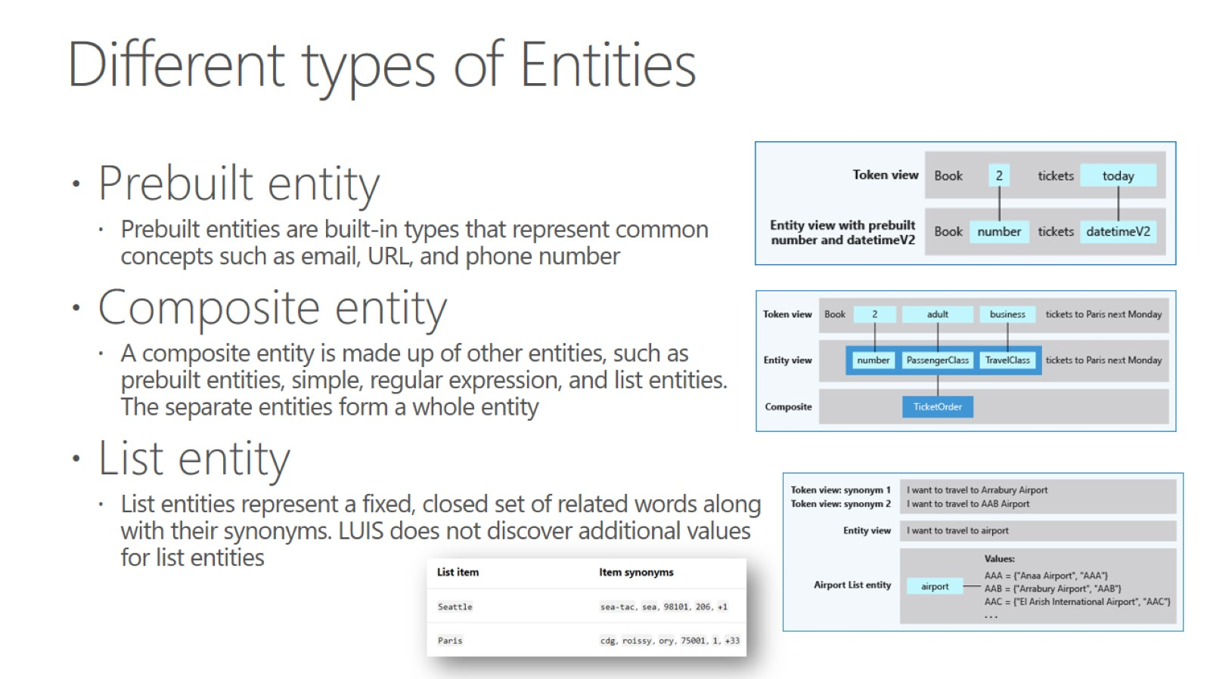
Different types of Entities

Slide 15
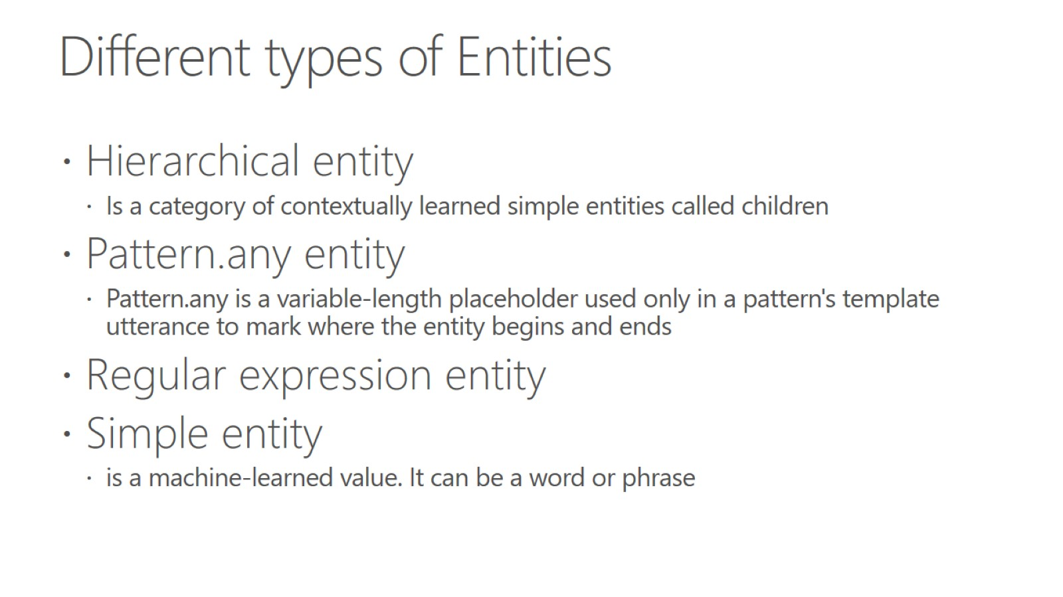
Different types of Entities

Slide 16
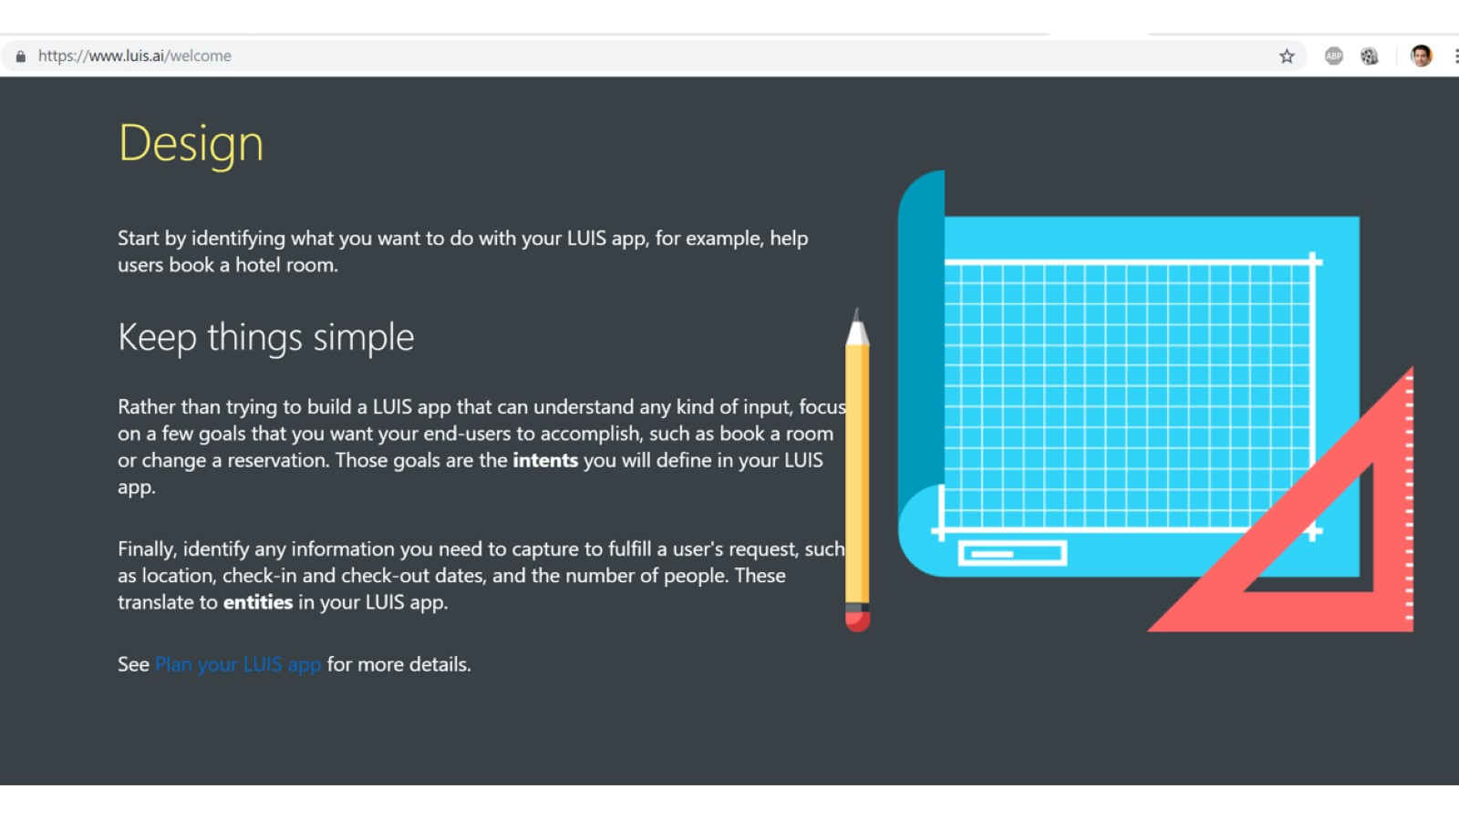

Slide 17
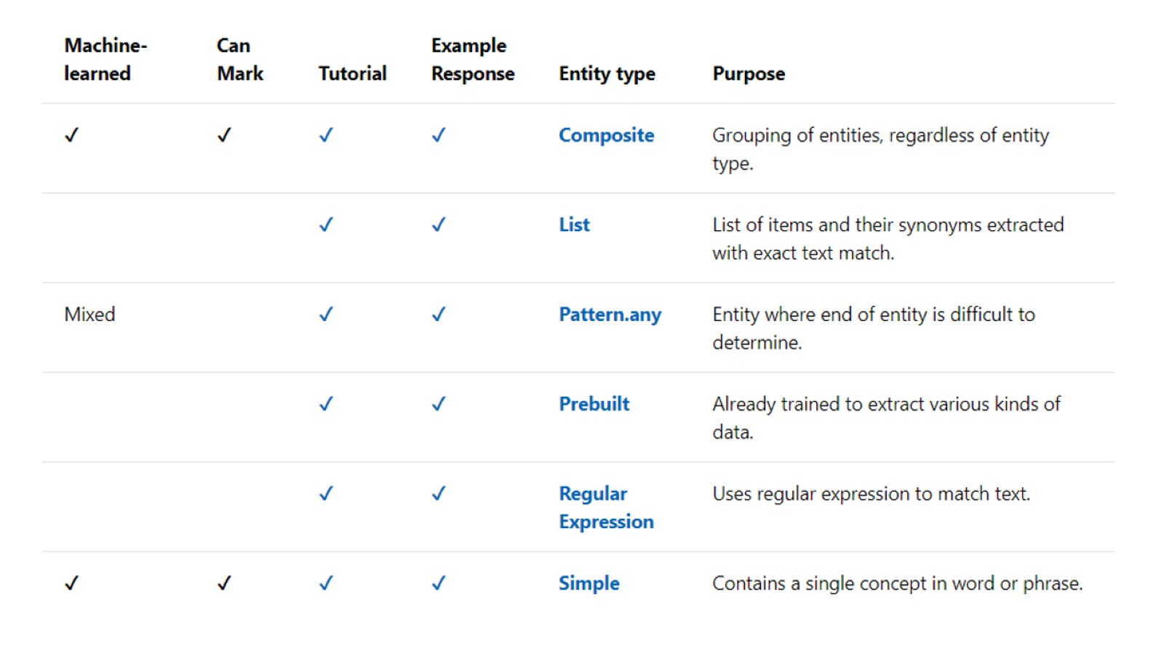

Slide 18
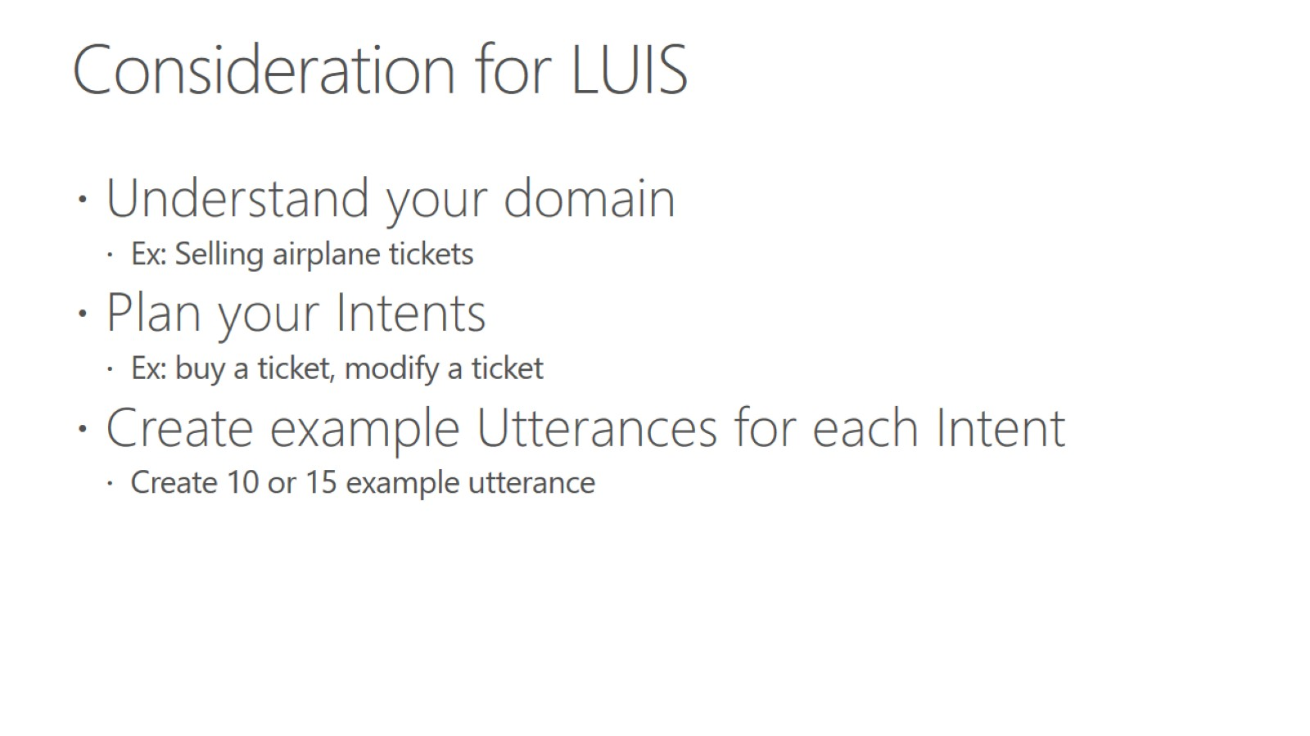
Consideration for LUIS

Slide 19
Hands on lab - Add conversational intelligence to your apps by using Language Understanding Intelligent Service (LUIS)
To access the lab go here - https://docs.microsoft.com/en-us/learn/modules/create-and-publish-a-luis-model/1-introduction
Let me know if you have any questions

Slide 20
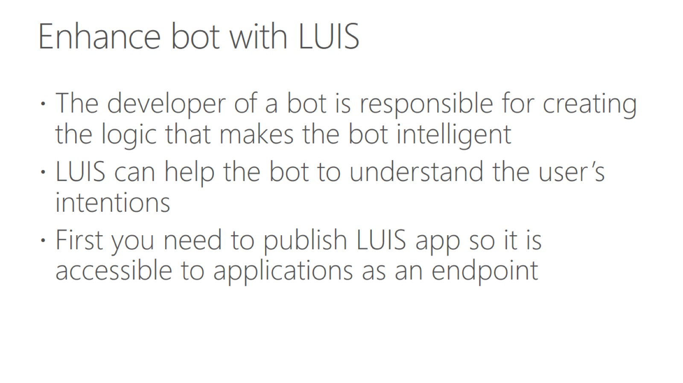
Enhance bot with LUIS

Slide 21
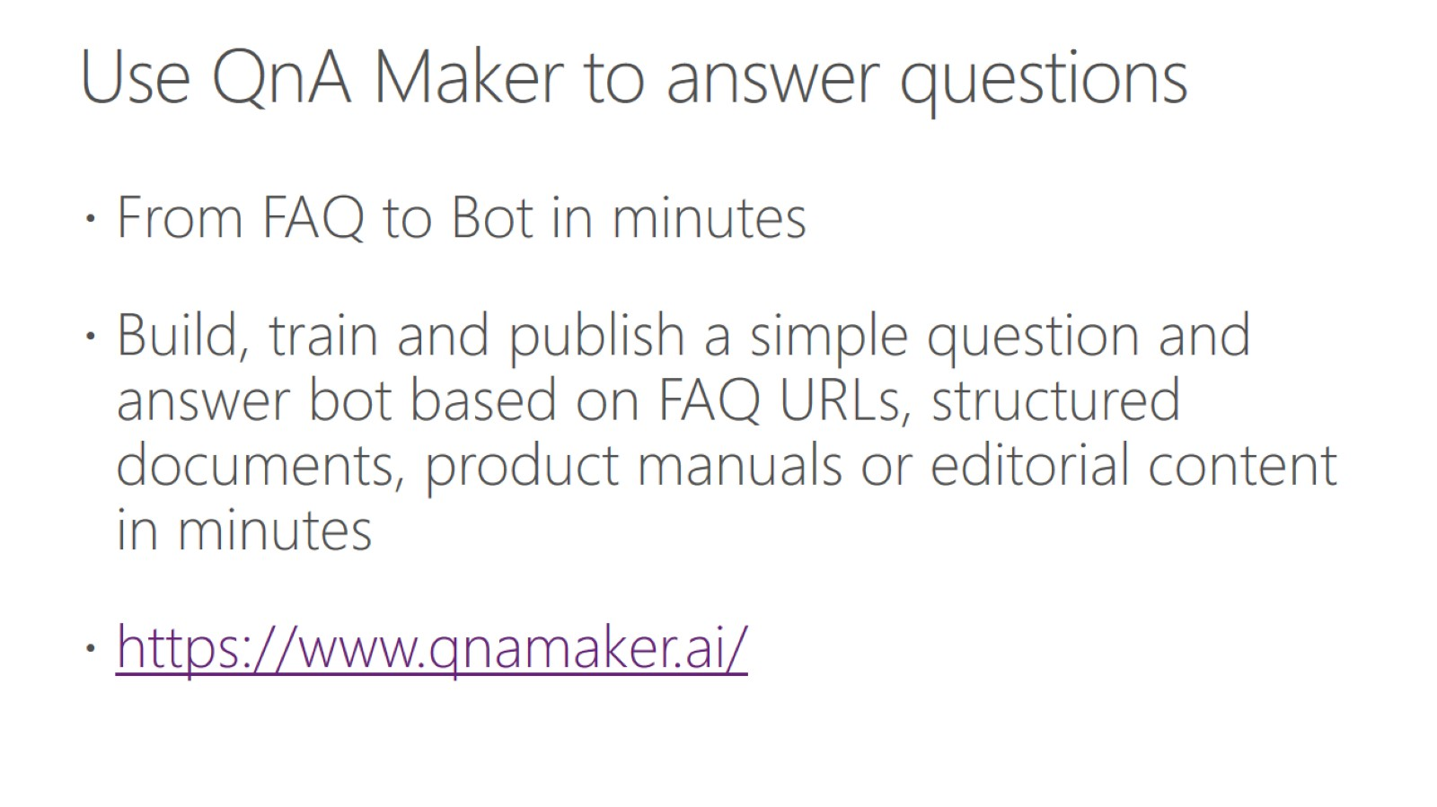
Use QnA Maker to answer questions

Slide 22
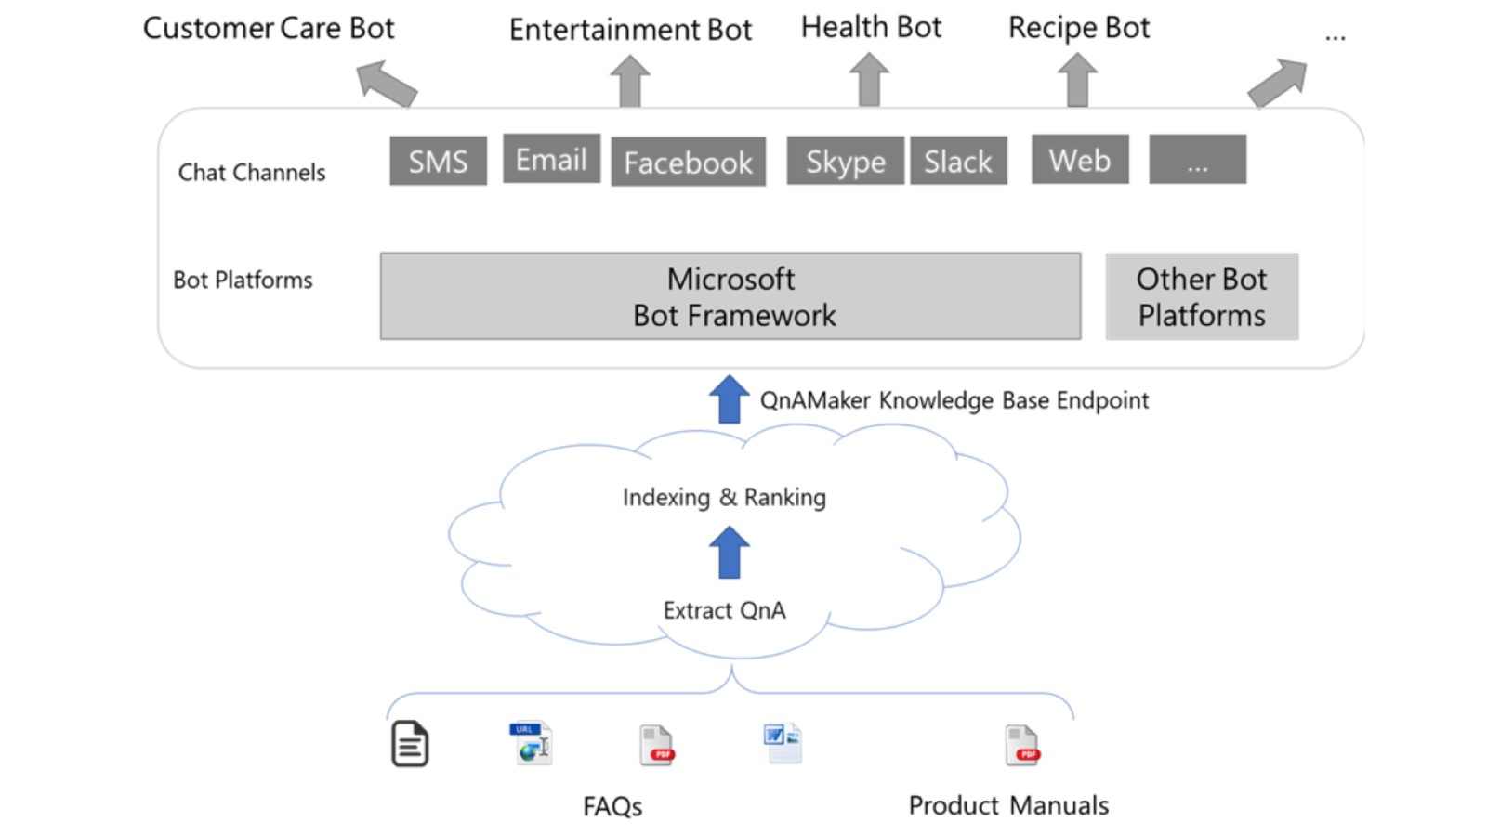

Slide 23
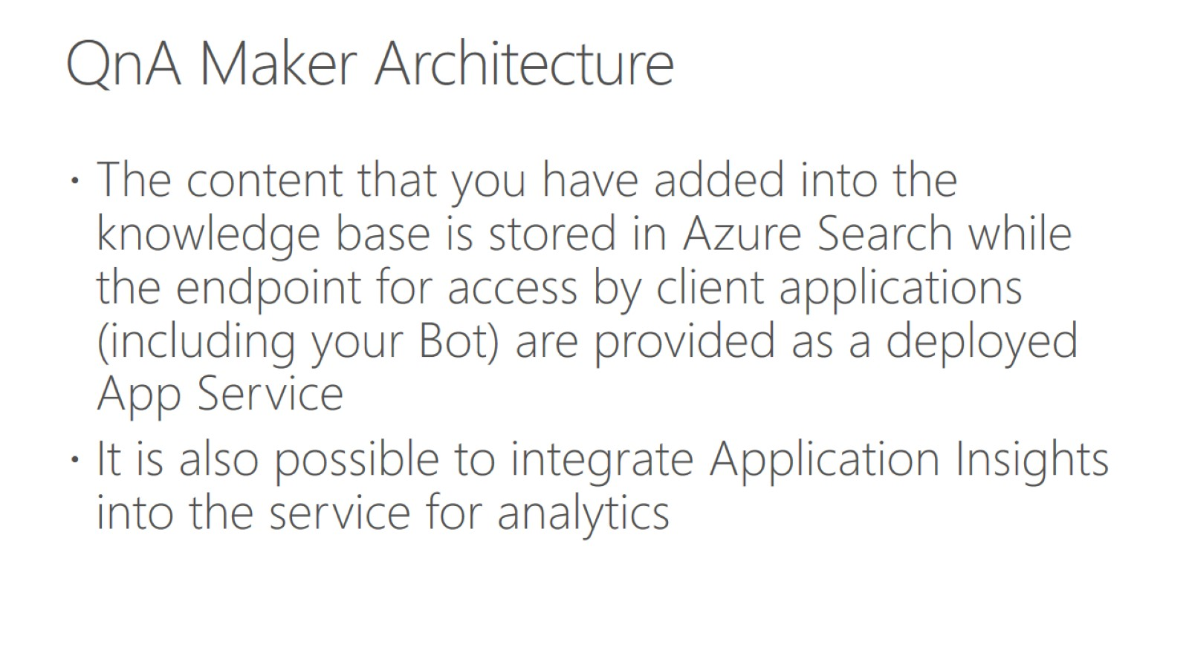
QnA Maker Architecture

Slide 24
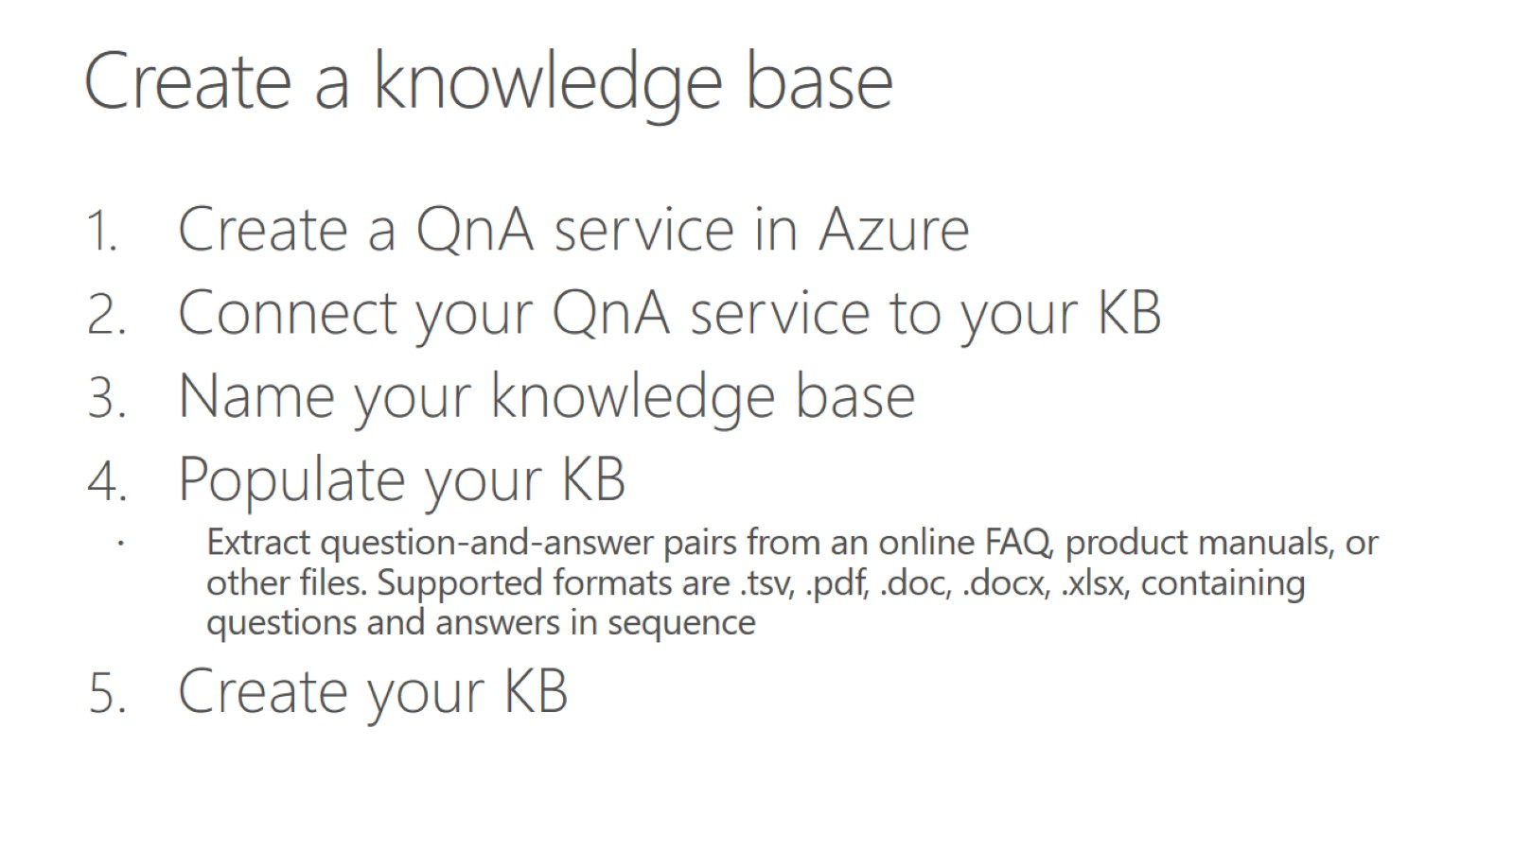
Create a knowledge base

Slide 25
Hands on lab - Build an FAQ chatbot with QnA Maker and Azure Bot Service
To access the lab go here - https://docs.microsoft.com/en-us/learn/modules/build-a-faq-chat-bot-with-qna-maker-and-azure-bot-service/1-introduction
Let me know if you have any questions

Slide 26
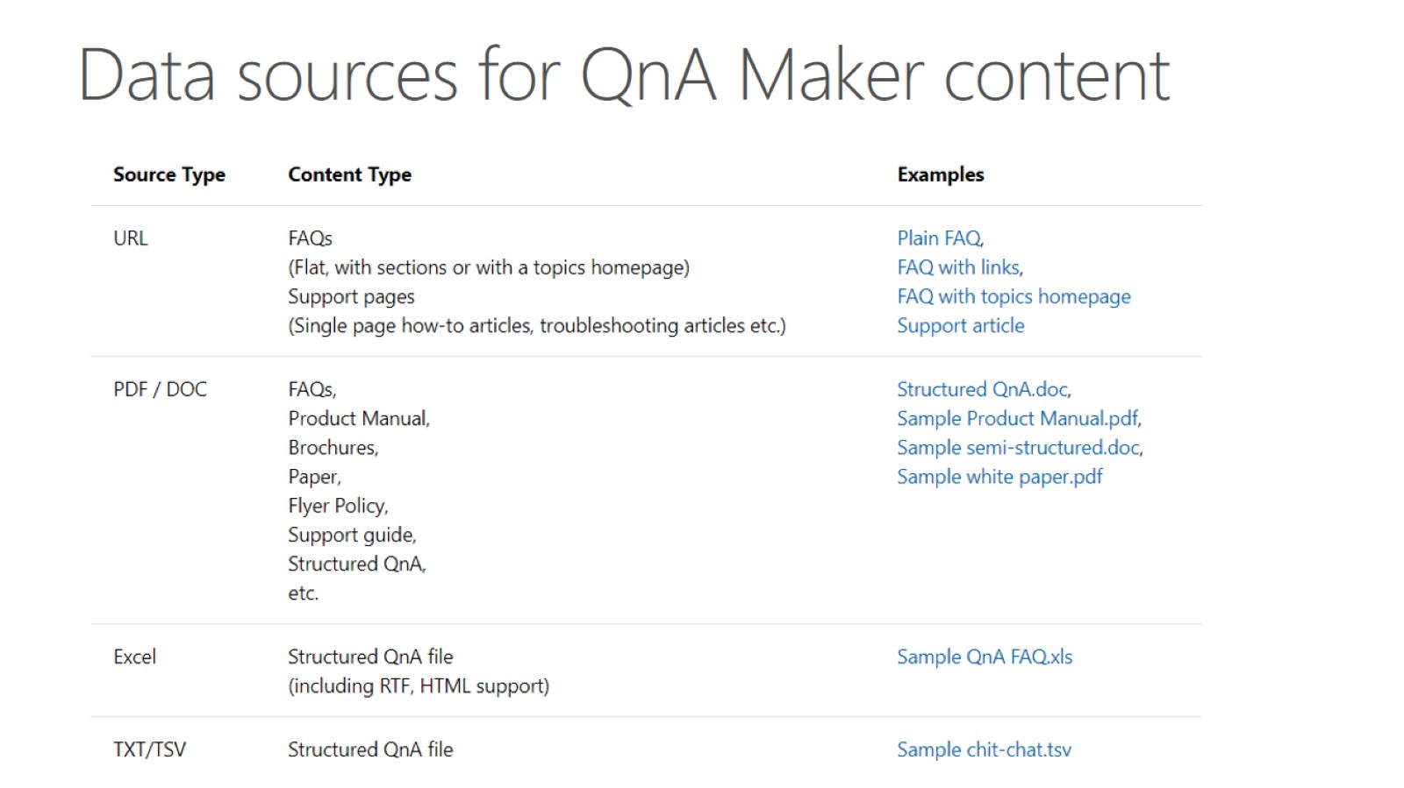
Data sources for QnA Maker content

Slide 27
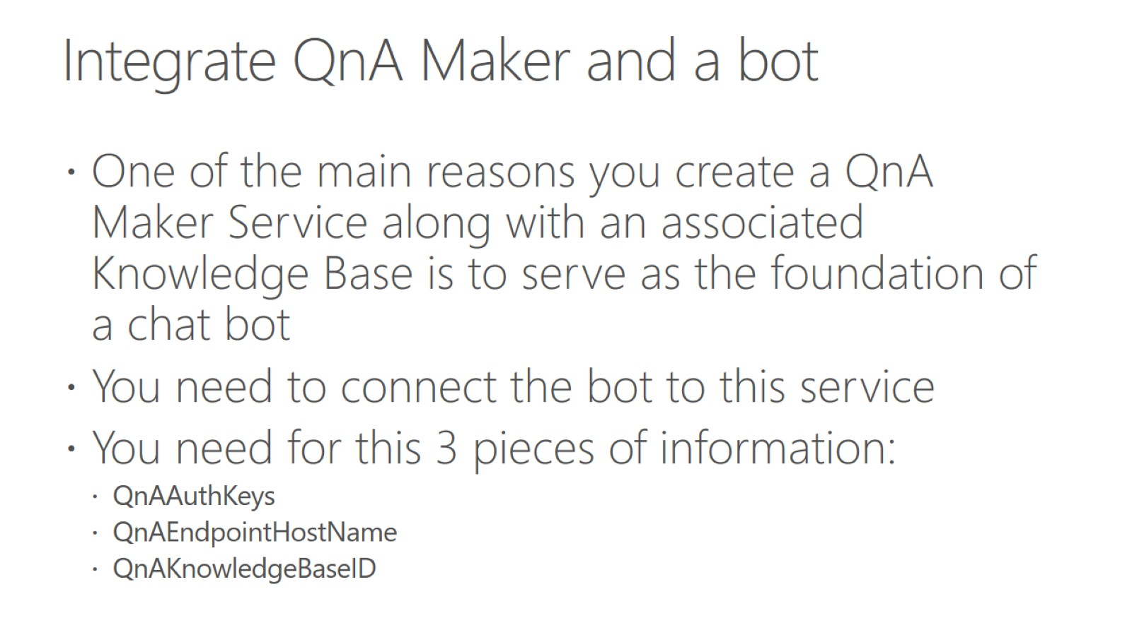
Integrate QnA Maker and a bot

Slide 28
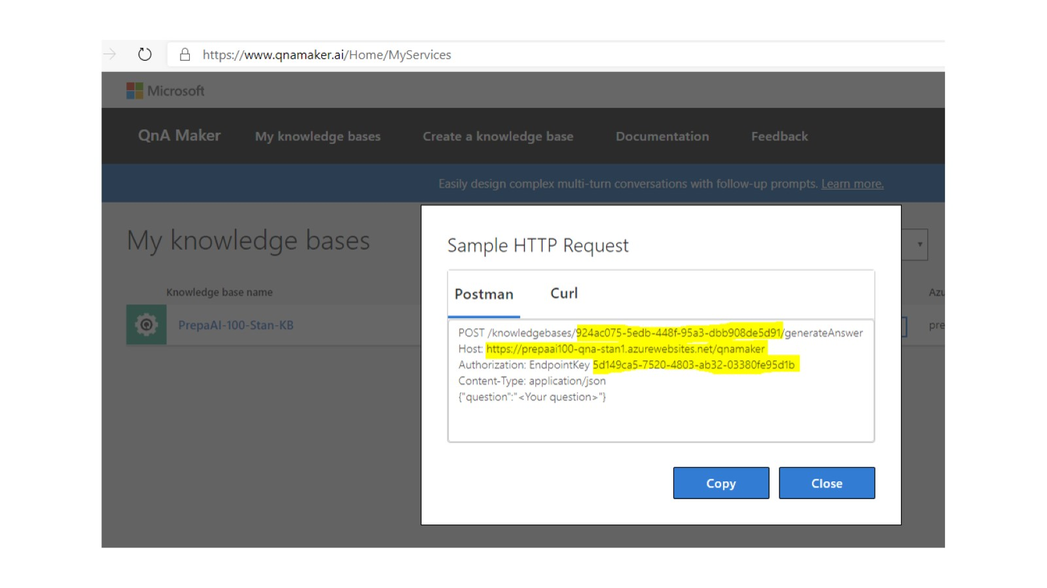

Slide 29
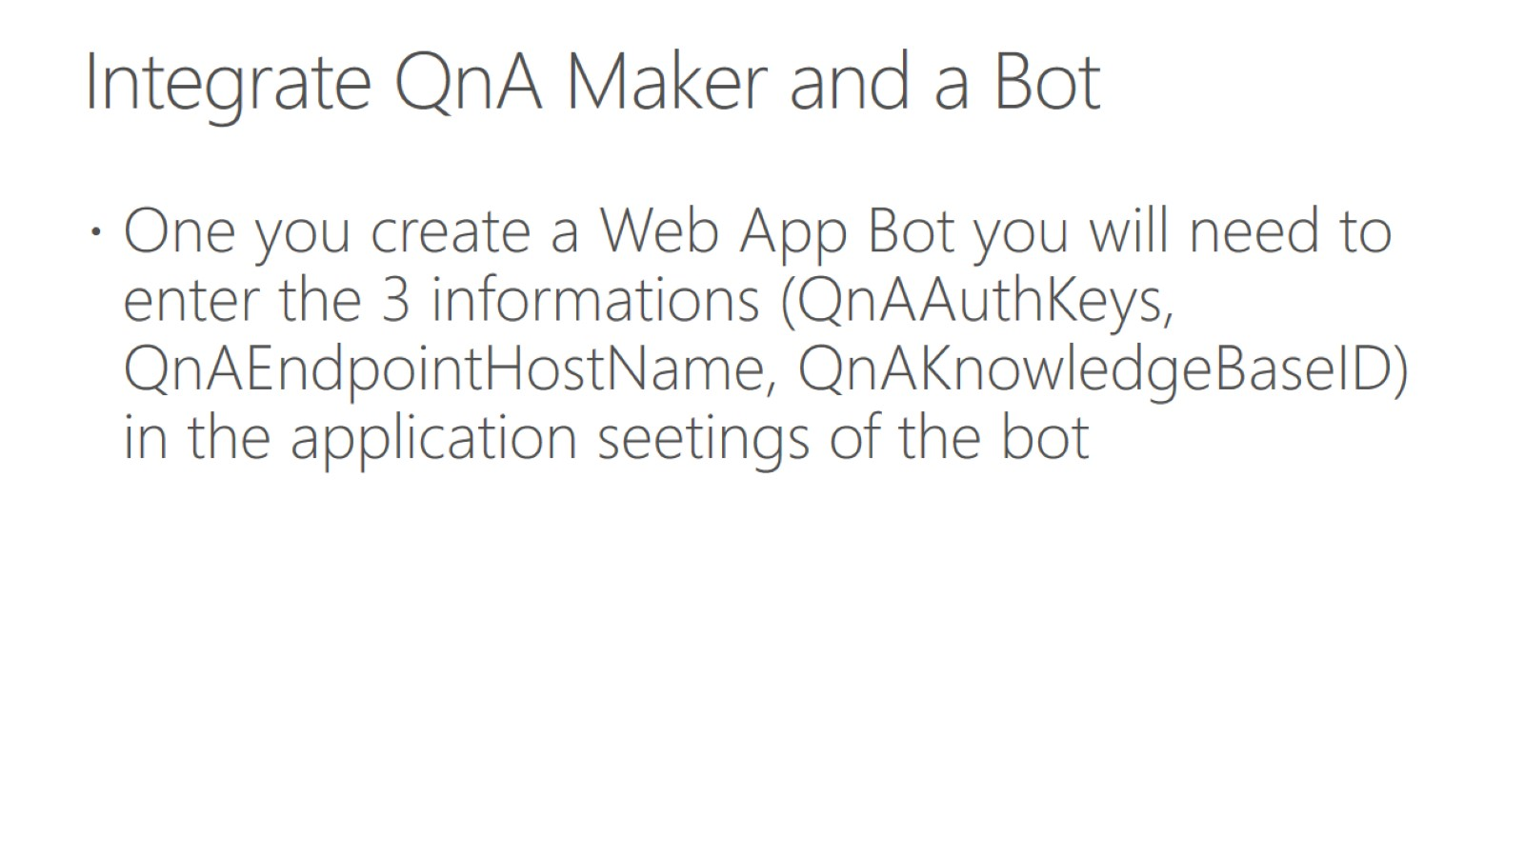
Integrate QnA Maker and a Bot

Slide 30
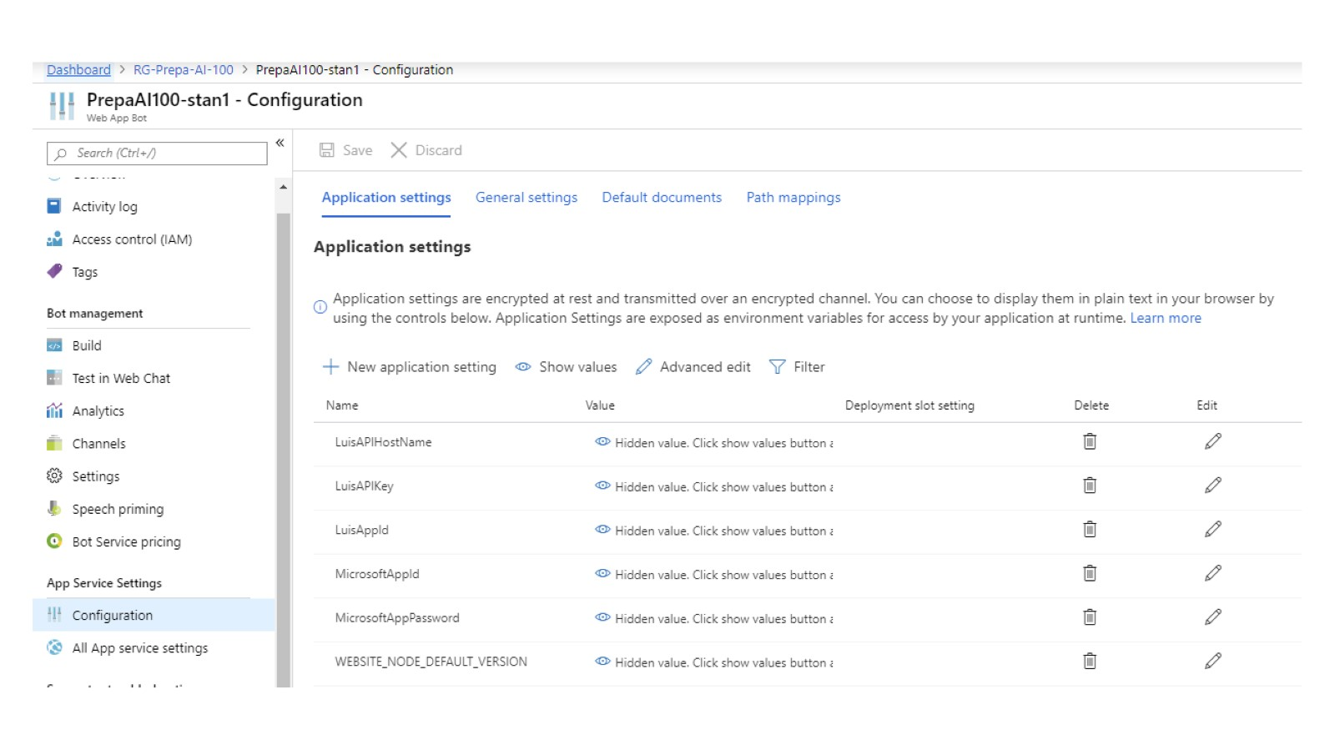

Slide 31
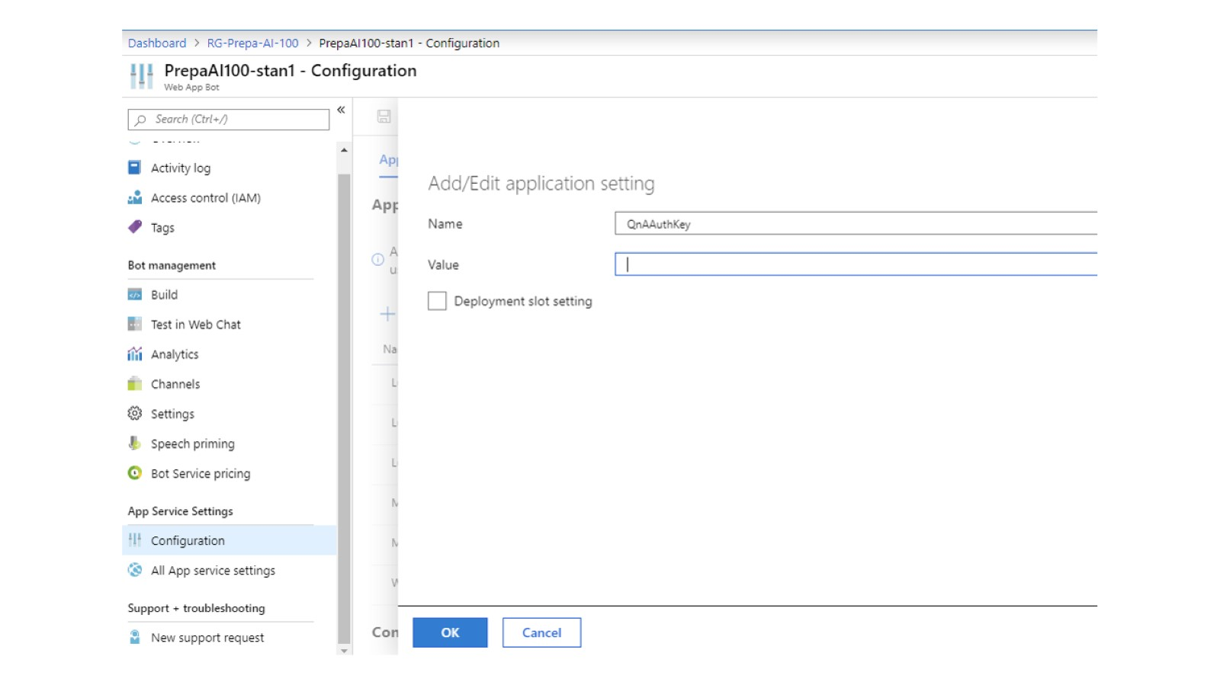

Slide 32
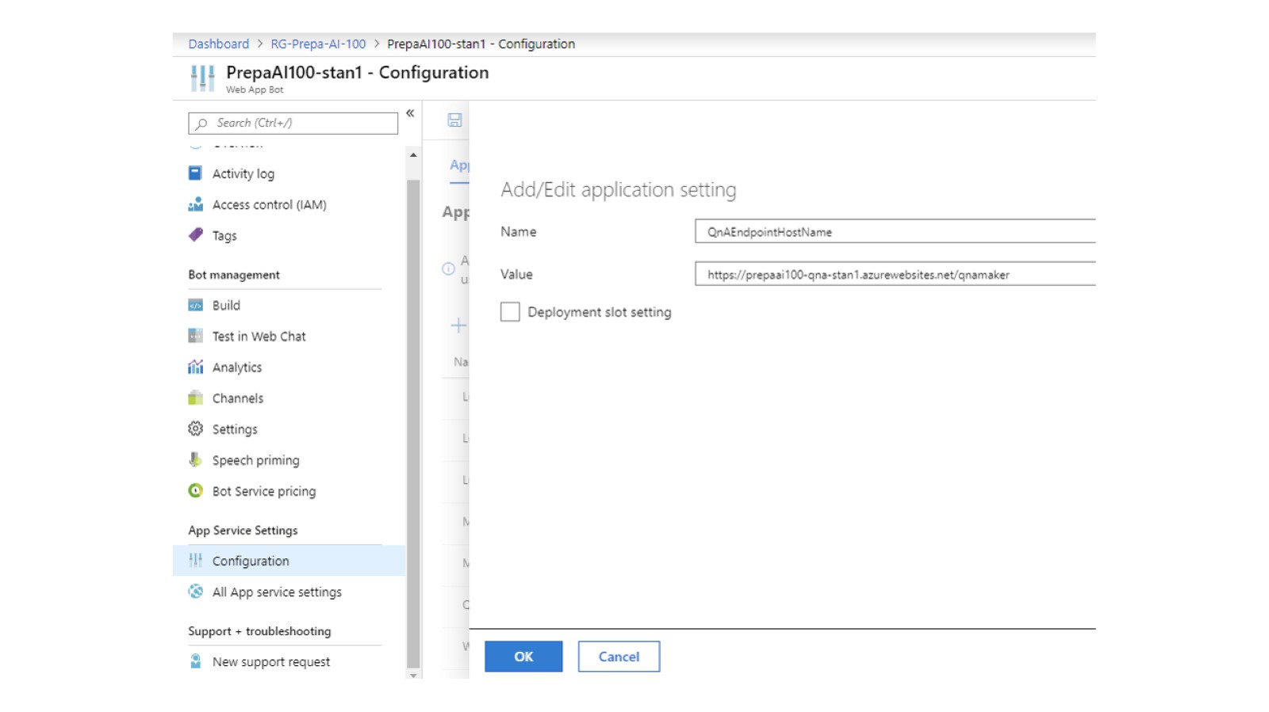

Slide 33
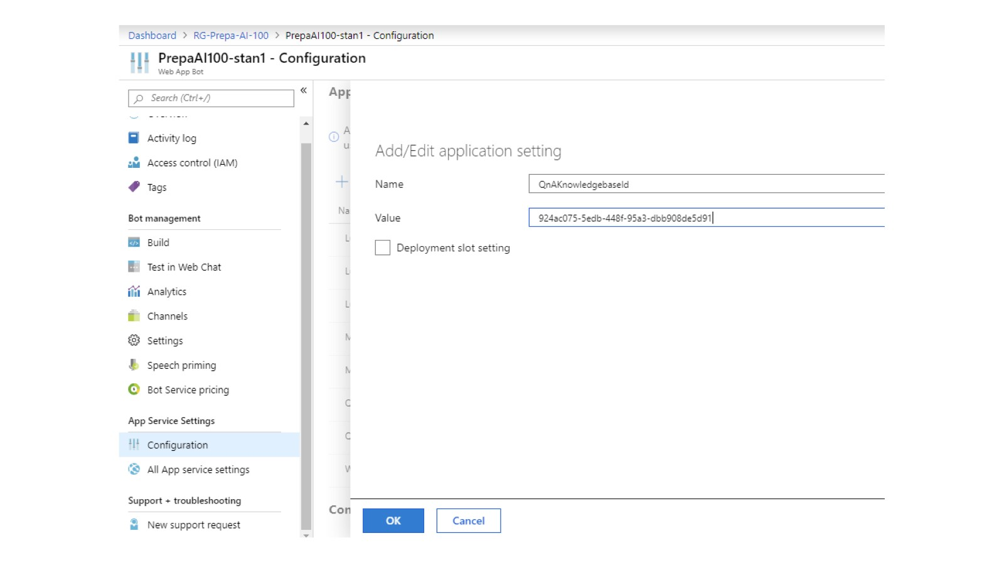

Slide 34
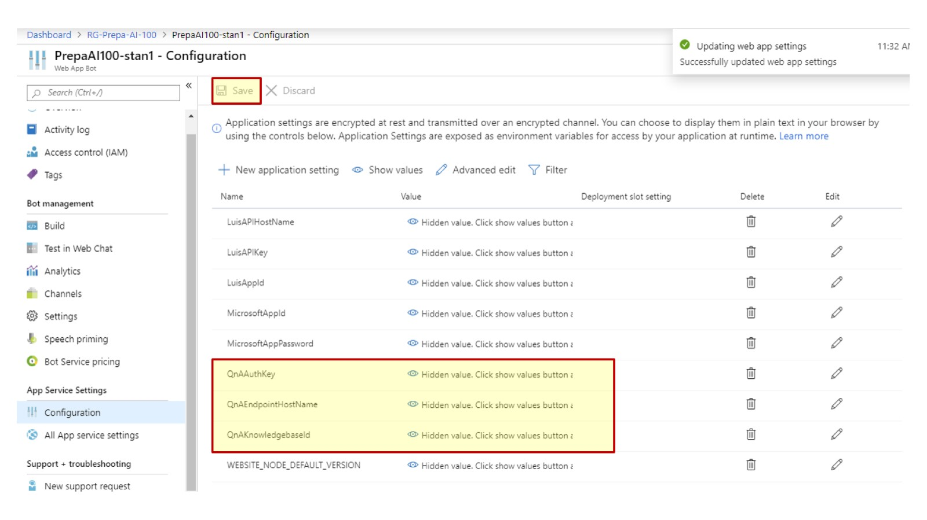

Slide 35
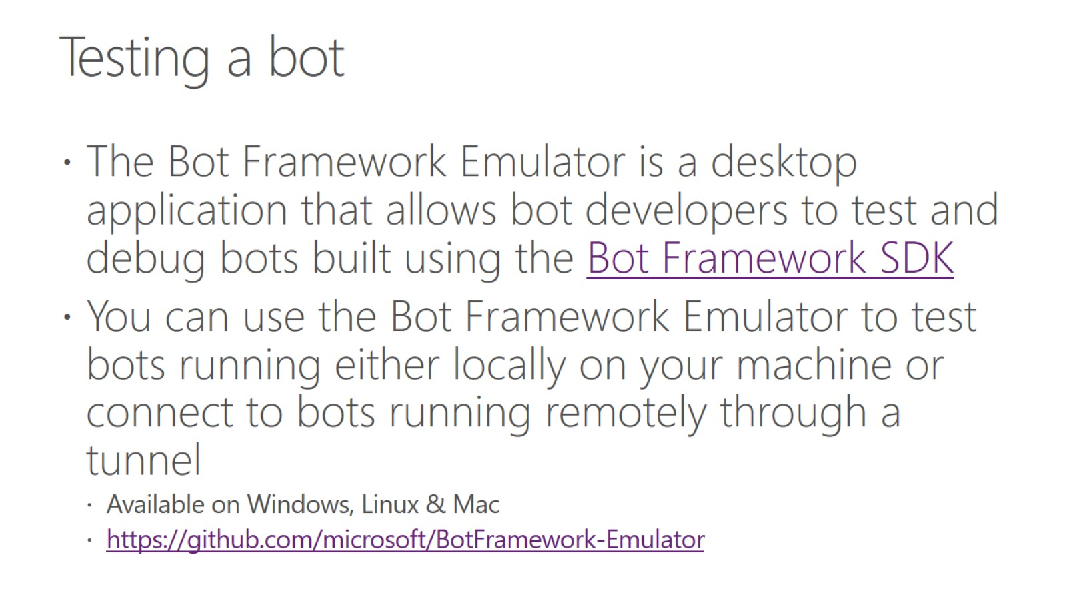
Testing a bot

Slide 36
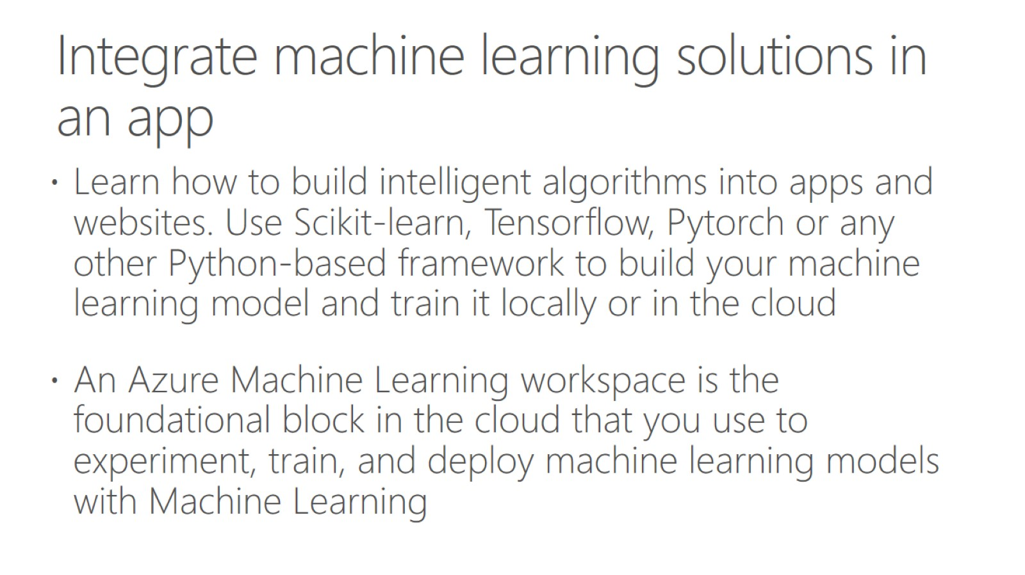
Integrate machine learning solutions in an app

Slide 37
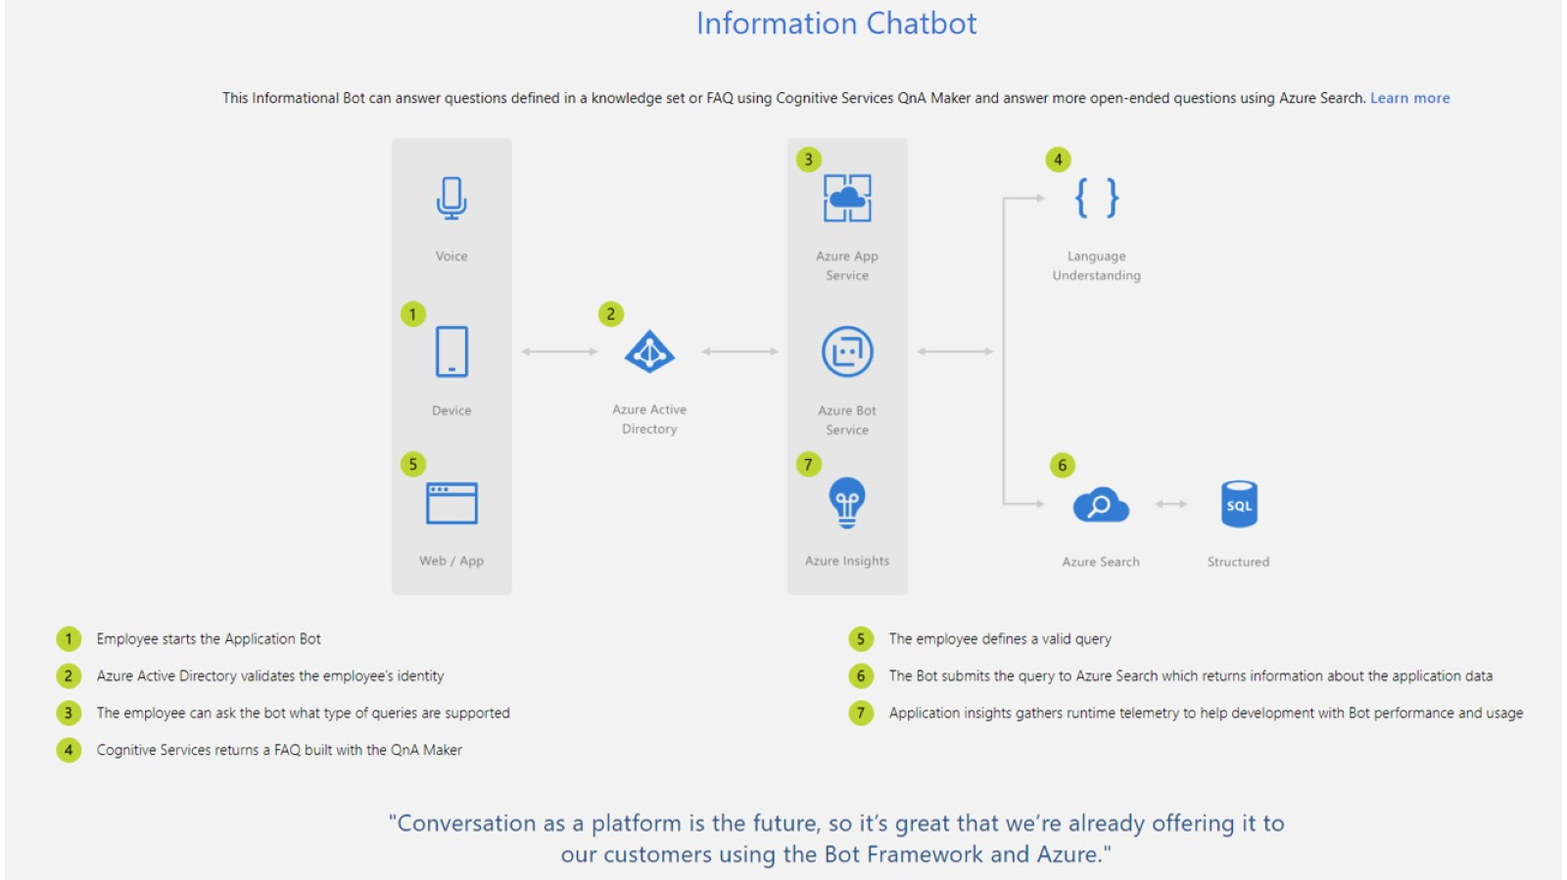

Slide 38
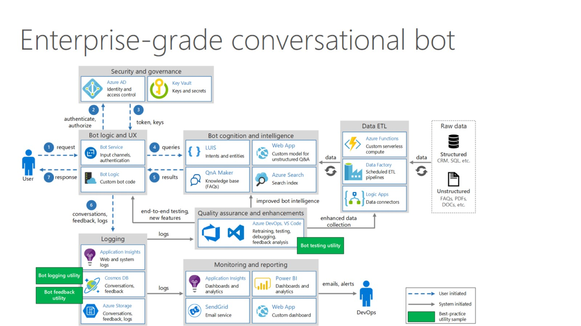

Slide 39
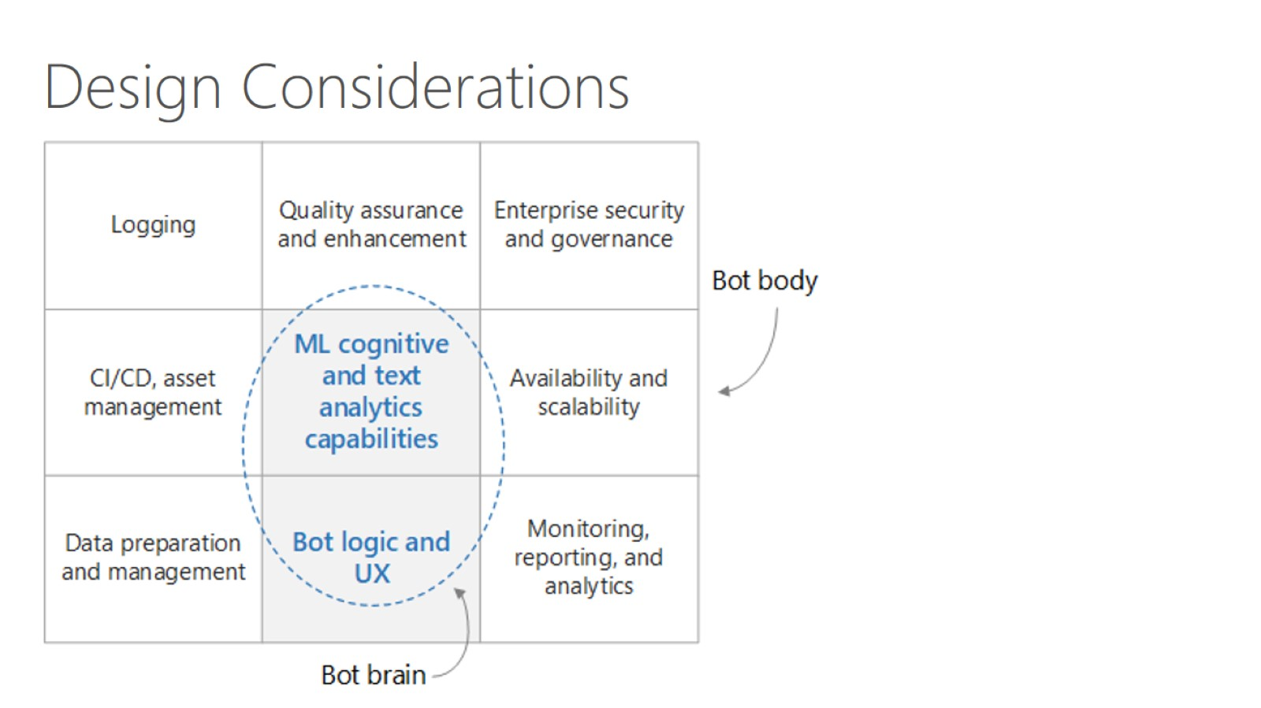

Slide 40
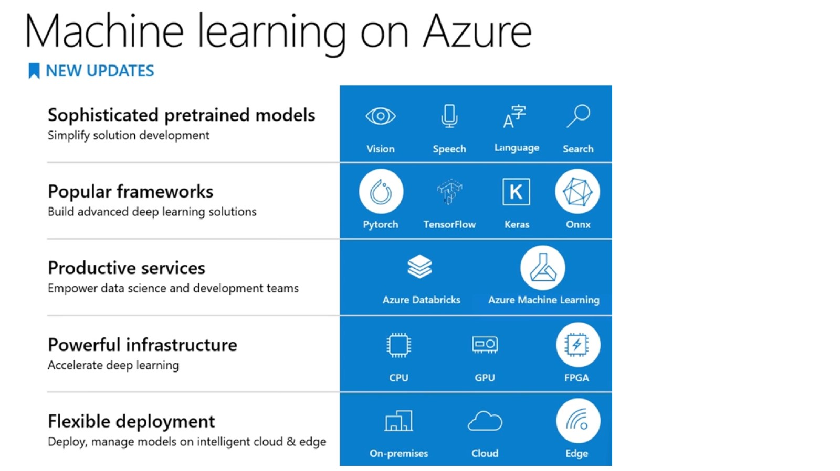

Slide 41
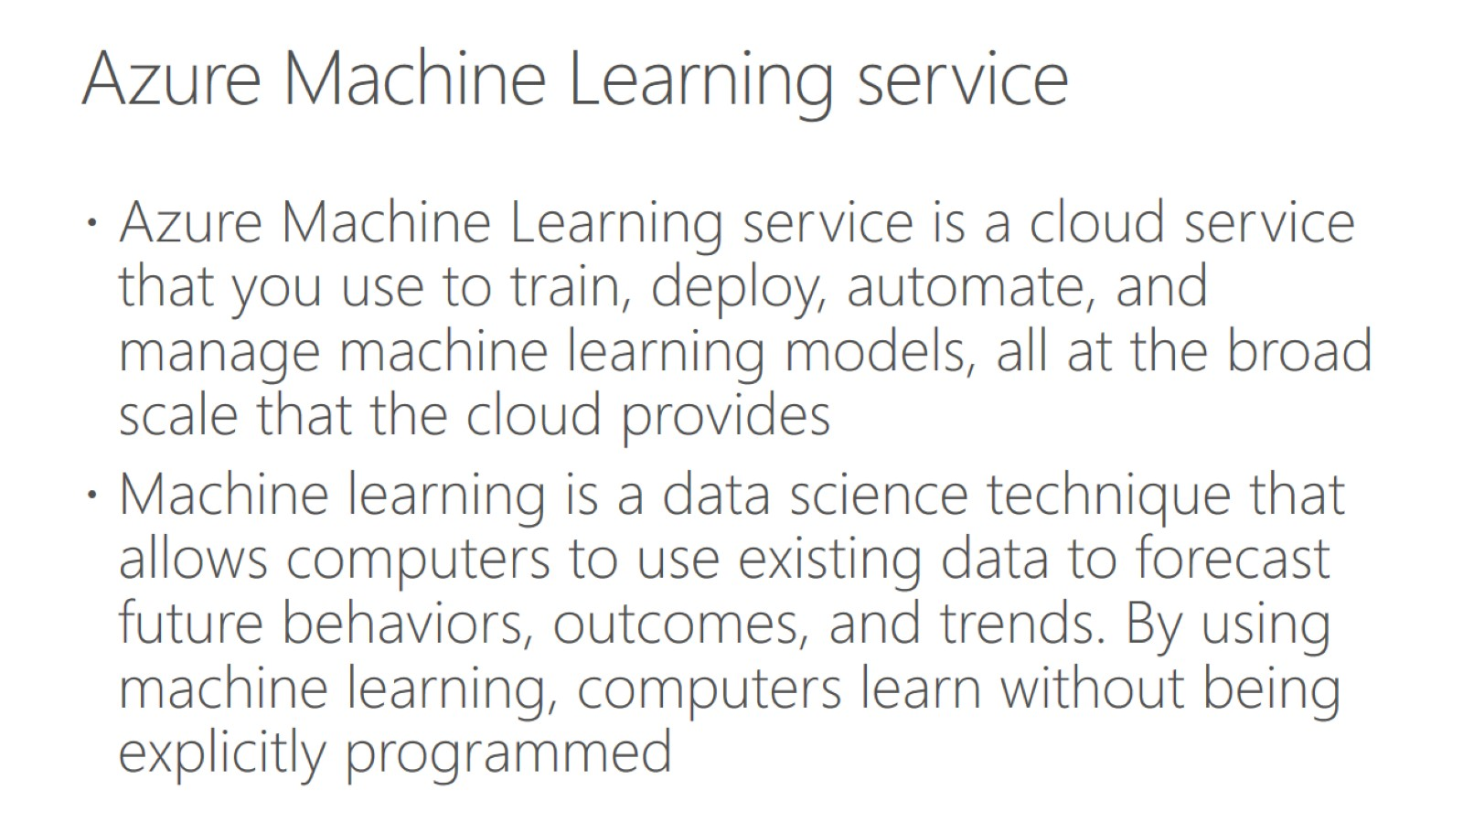
Azure Machine Learning service

Slide 42
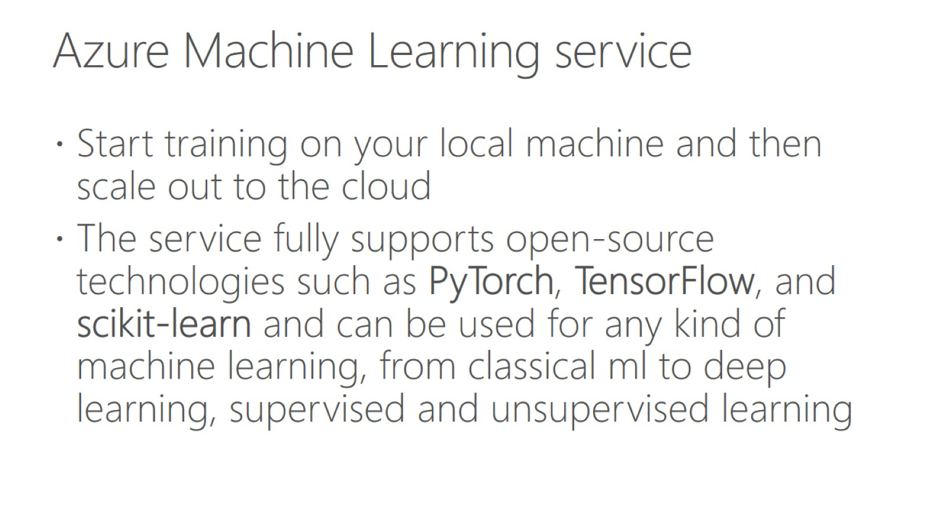
Azure Machine Learning service

Slide 43
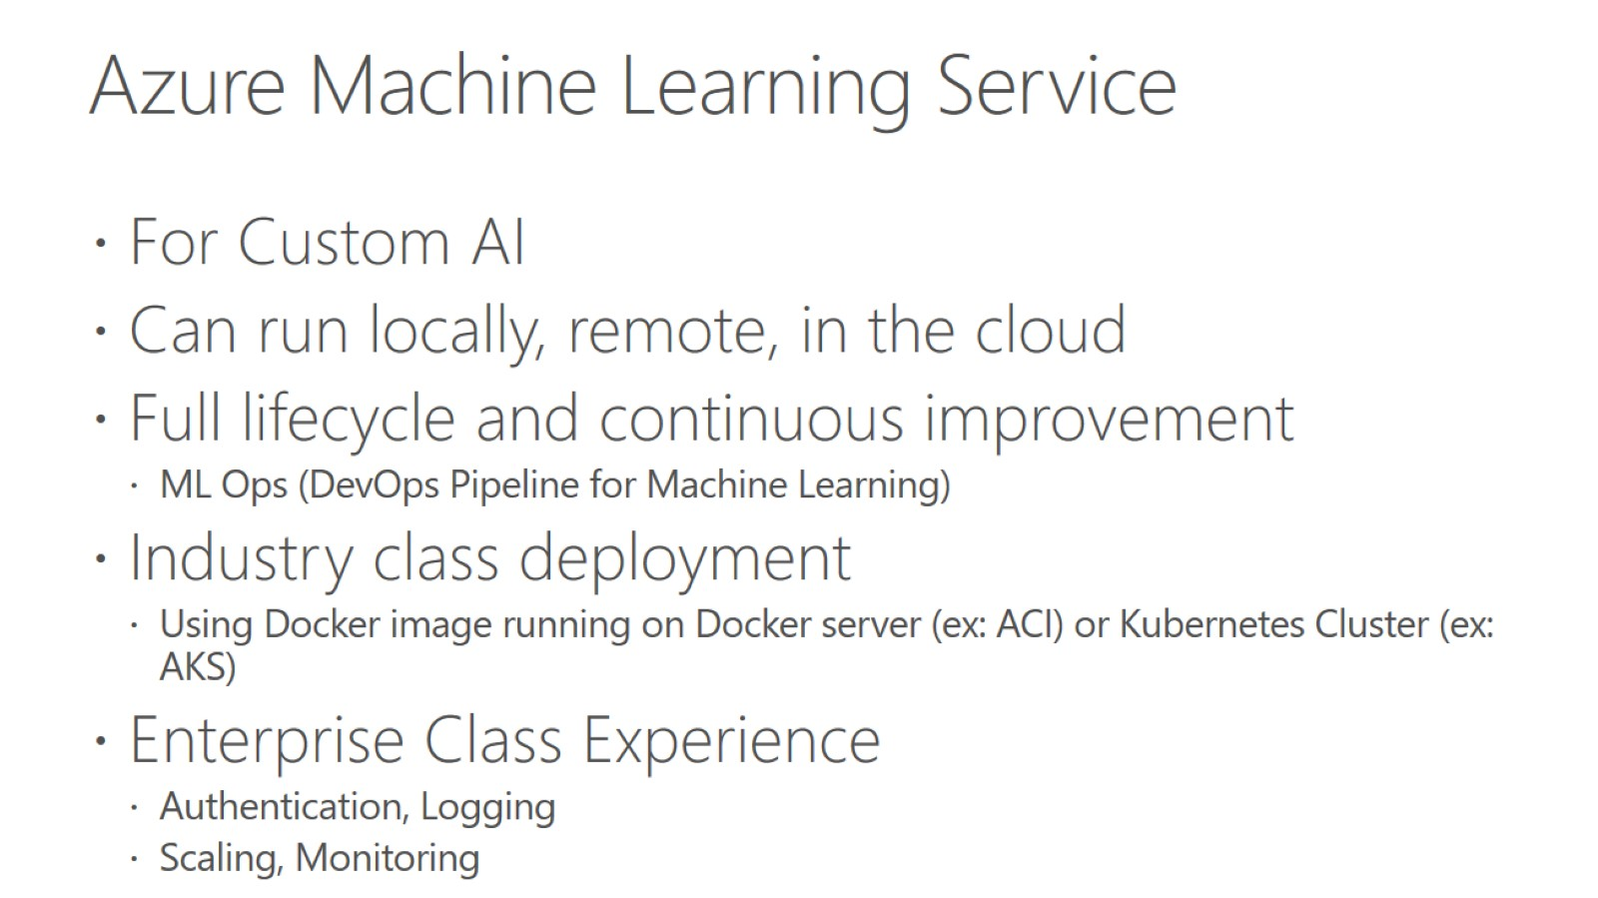
Azure Machine Learning Service

Slide 44
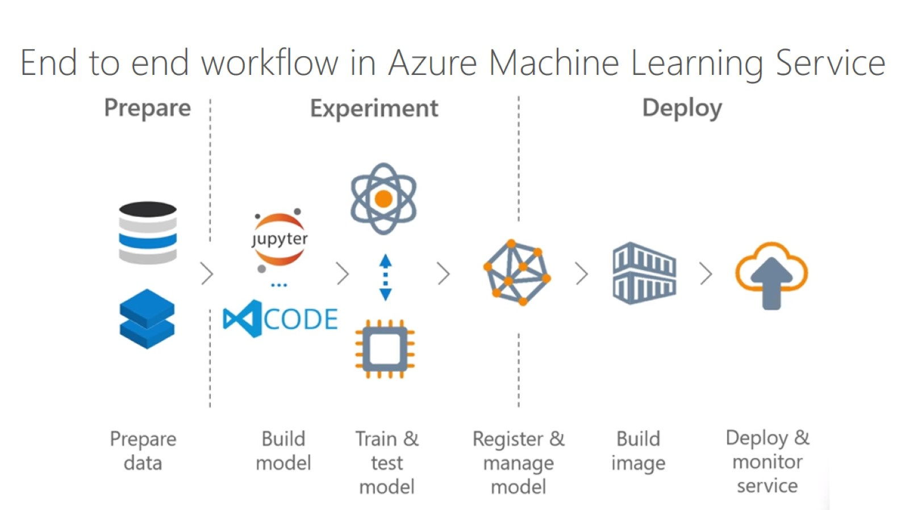

Slide 45
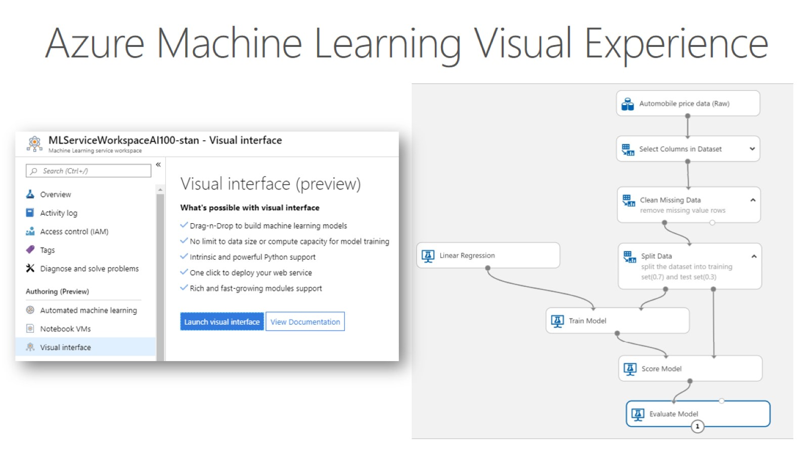
Azure Machine Learning Visual Experience

Slide 46
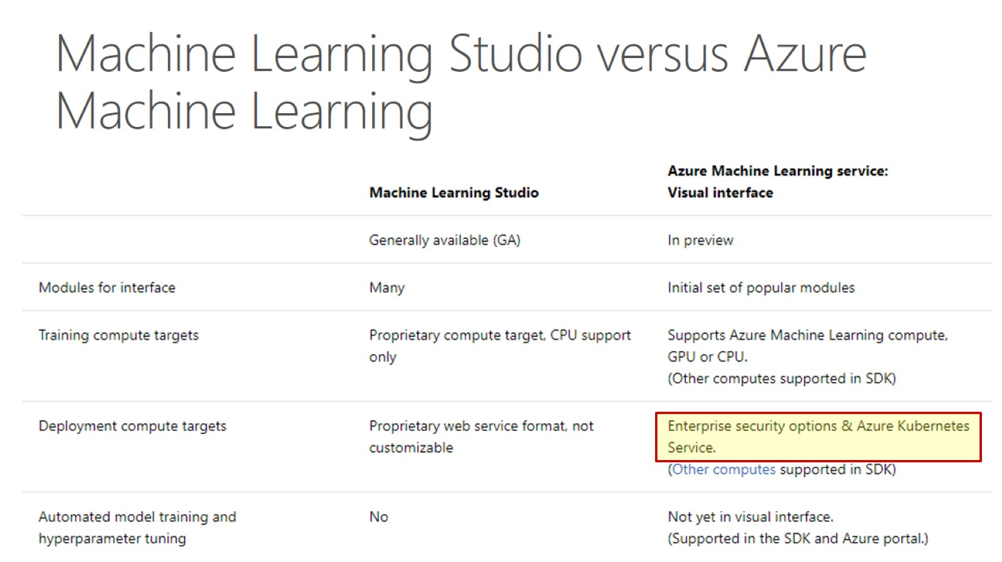
Machine Learning Studio versus Azure Machine Learning

Slide 47
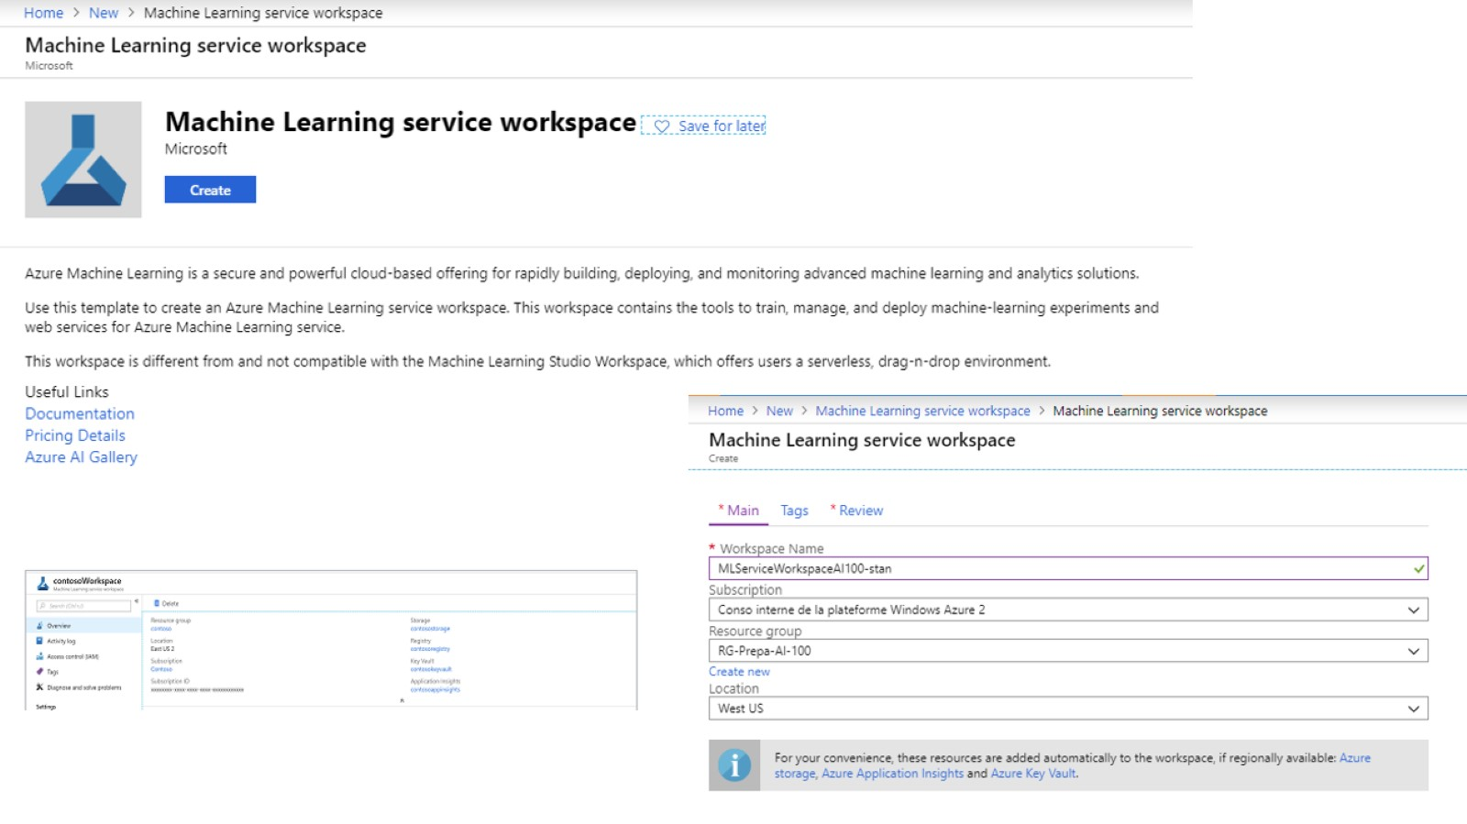

Slide 48
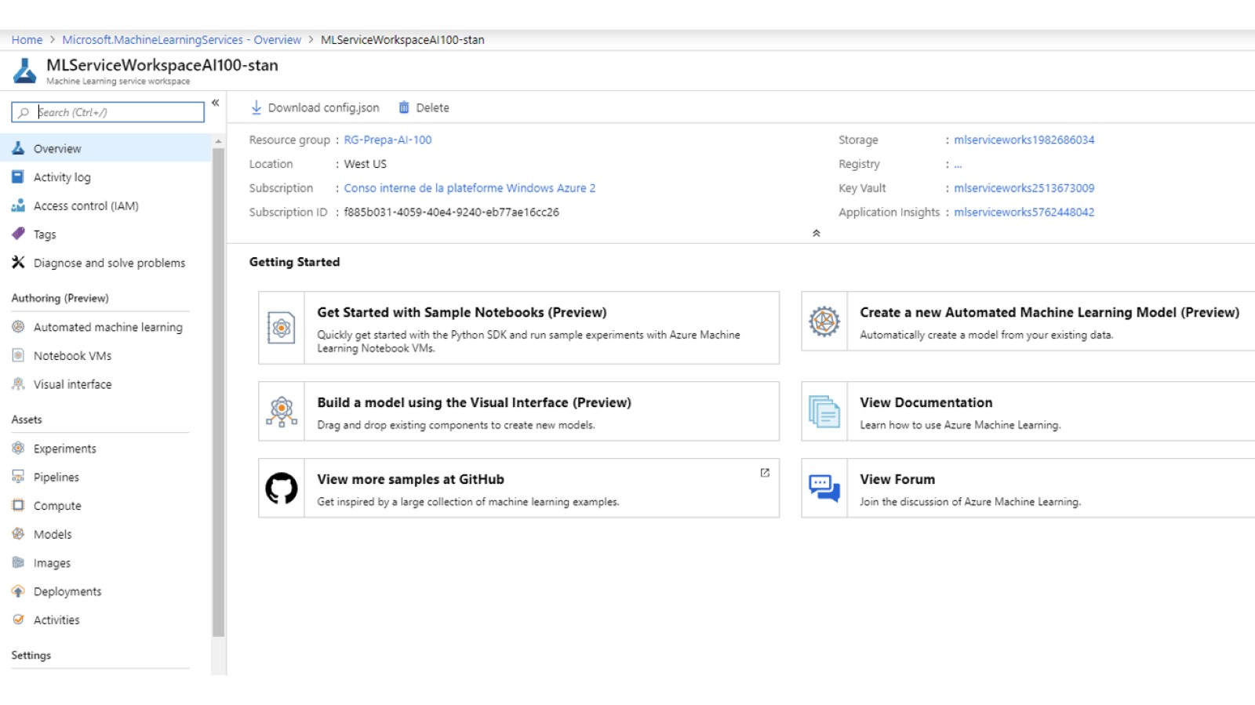

Slide 49
Hands on Lab: Create an Experiment in Azure Machine Learning Studio
Go to this link: https://docs.microsoft.com/en-us/learn/modules/create-machine-learning-studio-account/1-introduction/
Let me know if you have any questions

Slide 50
Hands on Lab: Create an Experiment in Azure Machine Learning Studio
Go to this link: https://docs.microsoft.com/en-us/learn/modules/create-an-experiment-in-ml-studio/1-introduction
Let me know if you have any questions

Slide 51
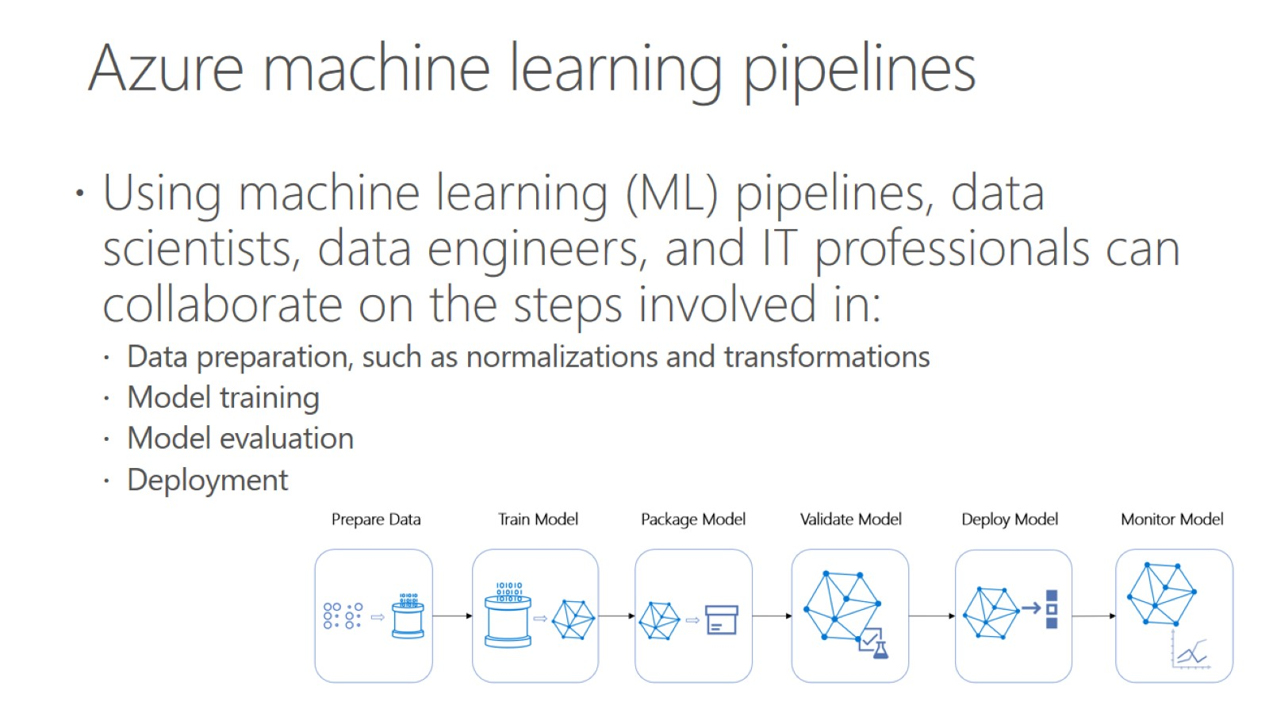
Azure machine learning pipelines

Slide 52
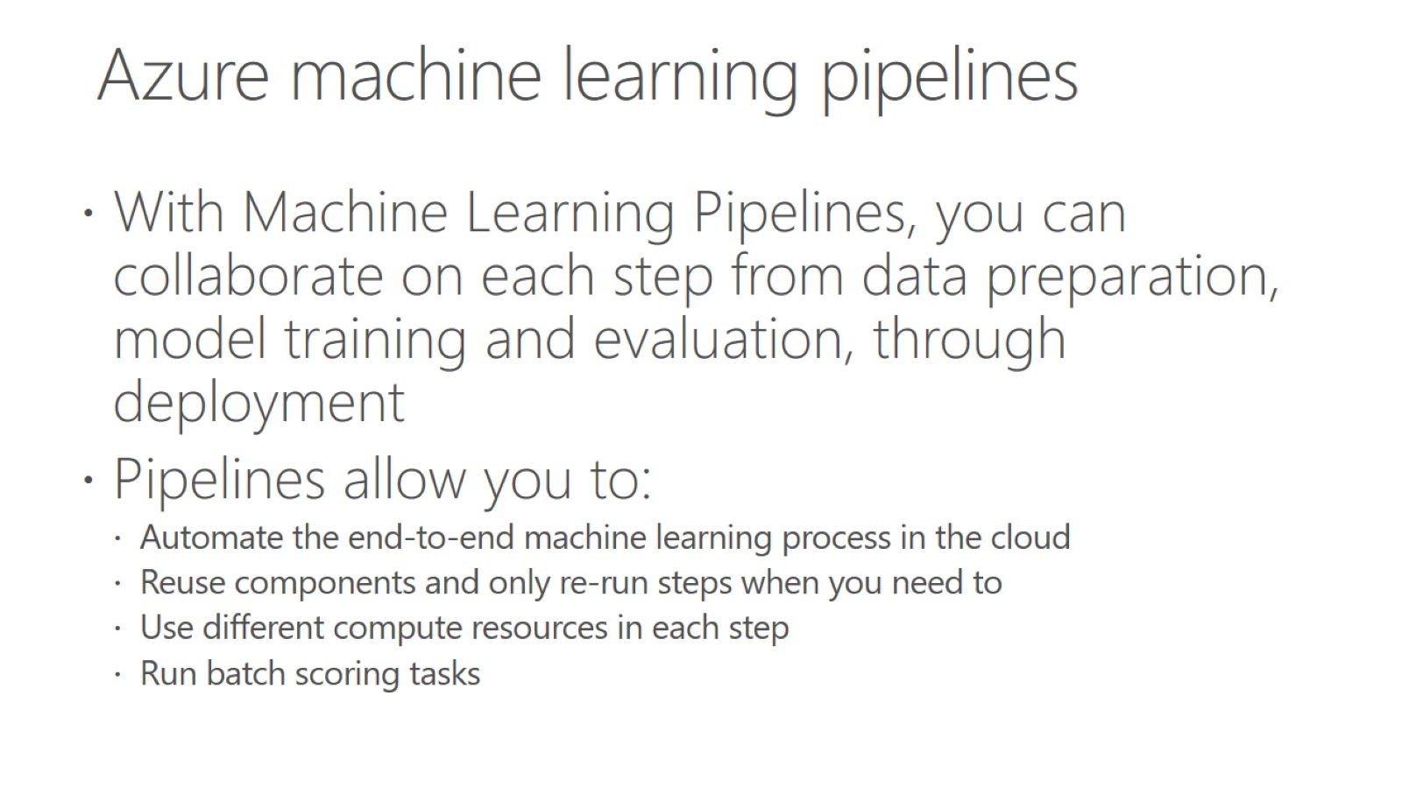
Azure machine learning pipelines

Slide 53
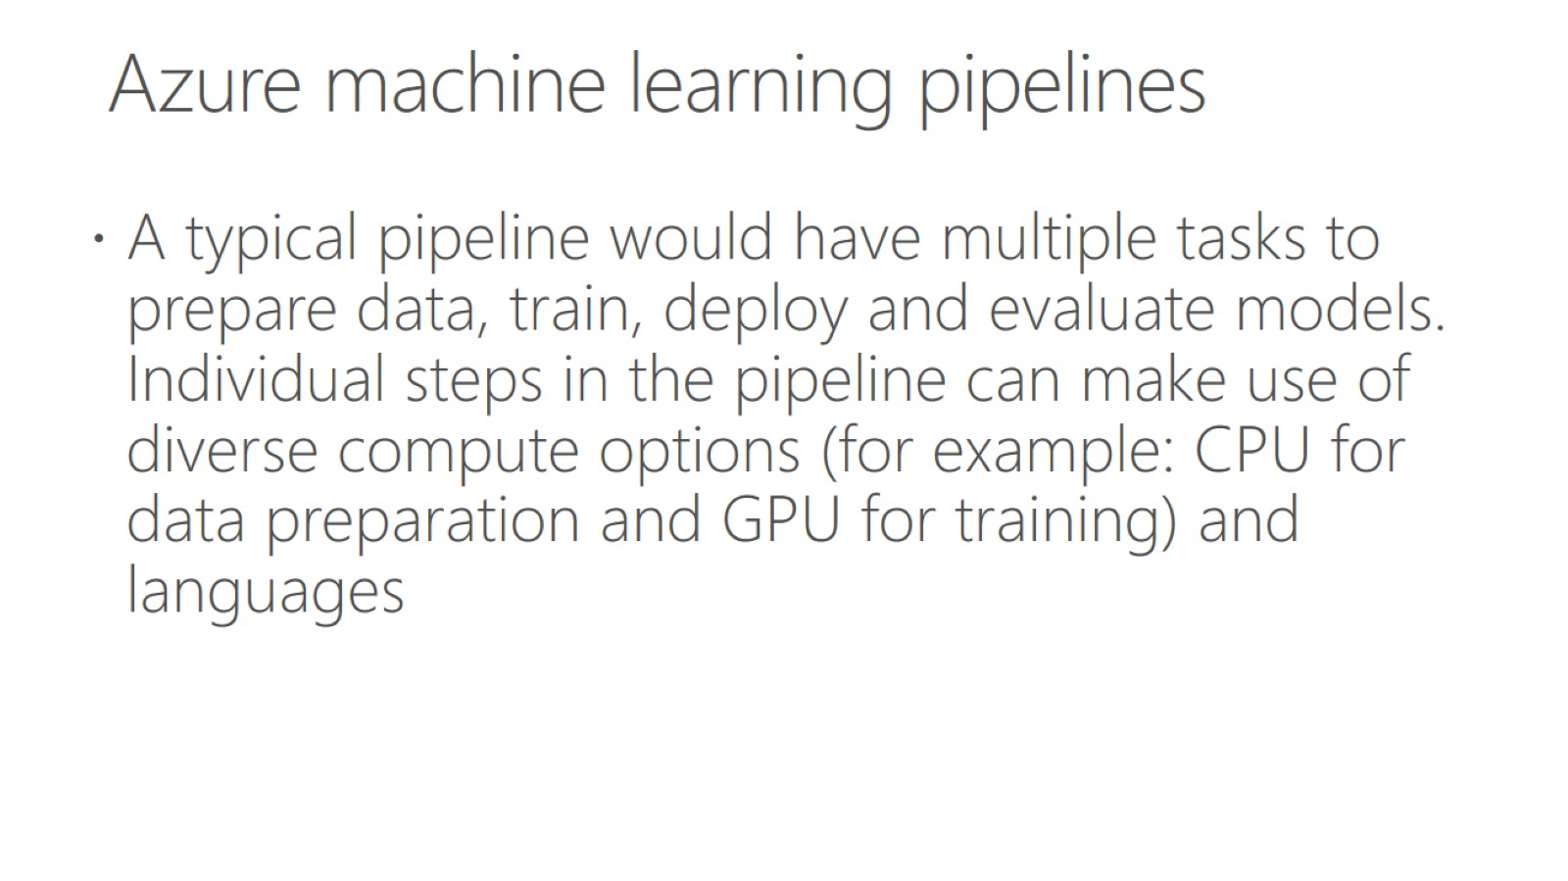
Azure machine learning pipelines

Slide 54
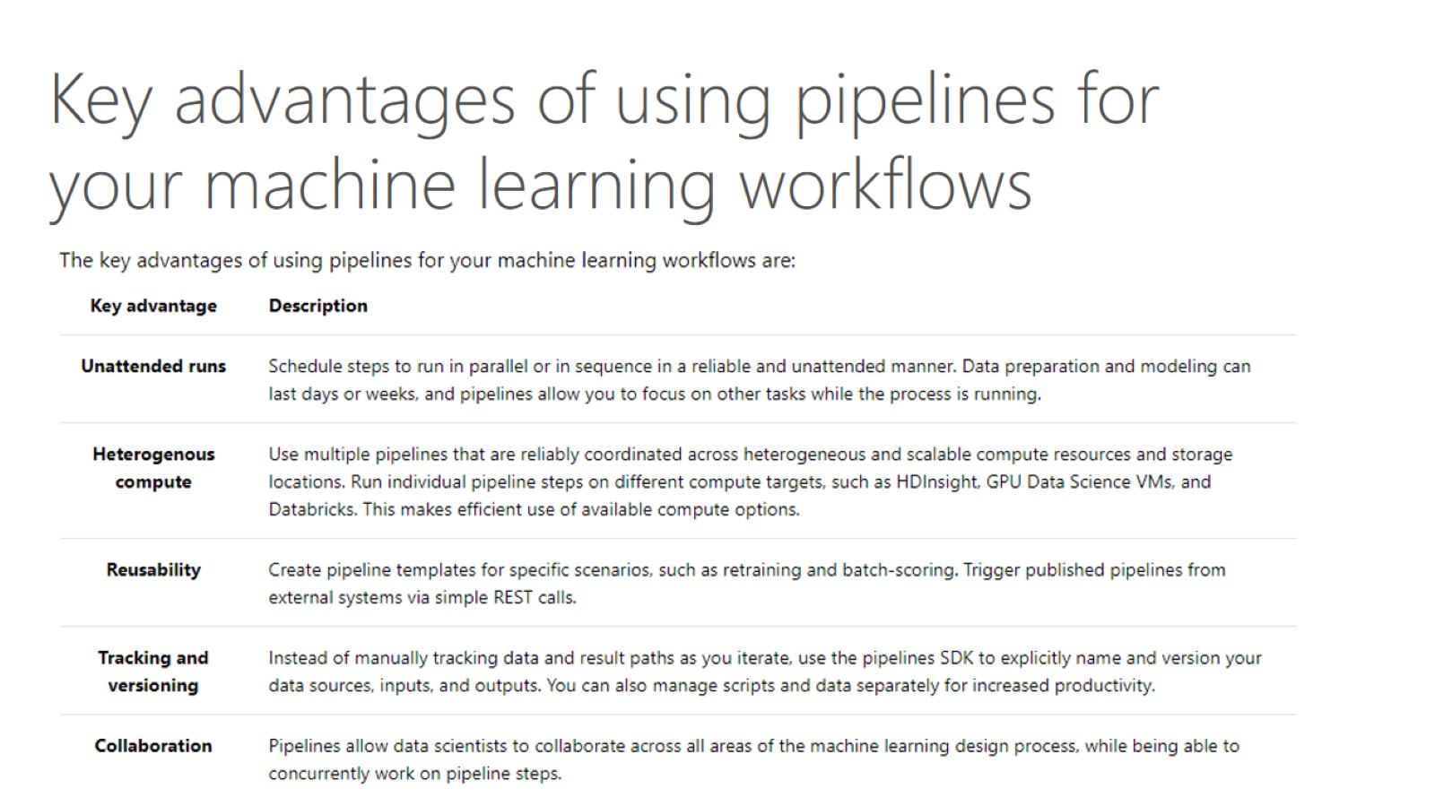

Slide 55

AI Pipelines

Slide 56


Slide 57

Azure Machine Learning Pipeline

Slide 58

Inference

Slide 59

Deploy a model

Slide 60

Choose a compute target

Slide 61

Deploy a model to an Azure Kubernetes Service cluster

Slide 62

Deploy a model using a Custom Docker image

Slide 63

Machine Learning Pipelines

Slide 64

Azure AI Pipelines

Slide 65

Azure AI Pipelines

Slide 66

Data Science Virtual Machine

Slide 67

Azure AI Pipeline –model deployment (model is a Docker image)

Slide 68

Azure Datafactory

Slide 69


Slide 70

Design pipelines that call Azure Machine Learning models

Slide 71

Azure Data Factory pipeline

Slide 72

Select an AI solution that meet cost constraints

Slide 73
Integrate machine learning solutions in an app

Slide 76


Slide 77

Deep Learning with CPU, GPU or FPGA

Slide 78

Identify whether to create a GPU, FPGA, or CPU-based solution

Slide 79

FPGAs vs. CPU, GPU, and ASIC

Slide 80


Slide 81

FPGA in Azure

Slide 82

Identify whether to use a cloud-based, on-premises, or hybrid compute infrastructure

Slide 83

Select a compute solution that meets cost constraints

Slide 84

Machine Learning model training with AKS

Slide 85


Slide 86

Ensure that data adheres to compliance requirements defined by your organization

Slide 87

Design strategies to ensure the solution meets data privacy and industry standard regulations

